Slide 1
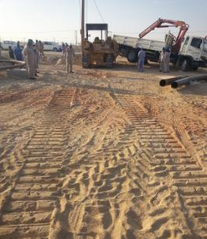
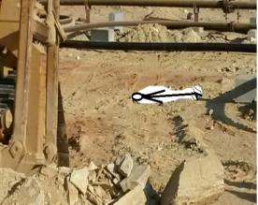
PDO Safety Advice
Use this Alert: Discuss in Tool Box Talks and HSE Meetings ➔ Distribute to contractors ➔ Post on HSE Notice Boards ➔ Include in site HSE Induction
Date : 01/02/2014
Injury: Non Accidental Death (NAD)
What happened?
The contractor mechanical crew finished their work and the operator parked the side boom crane. They walked over to the commuting vehicles parked by the road 32m away when the side boom crane collided with the rear side of a HIAB parked in front of the vehicles. The crew rushed to investigate and found the operator lying dead on the ground 8m behind where the crane had hit the HIAB. His head had been run over.
Your learning from this incident...
You should how to control the stress.
Your company will try and help you if you have personal problems so share them and seek help.
To look out for your colleagues especially if you notice a change in their behavior.
It is best to seek help and share a problem rather than to keep it to yourself
Contact: MSE54 for further information or visit the HSE Website Learning No11 01/02/2014

Slide 2
Management learning's
Use this Alert: Distribute to contractors ➔ Discuss in Meetings
Date : 01/02/2014
Injury : Non accidental death (NAD)
As a learning from this incident and ensure continual improvement all Contract Managers are to review their HSE HEMP against the questions asked below:
Confirm the following:
Do you train your employees on stress management?
Do you have a social specialist who your employees can approach for assistance?
Do you have social welfare programes for your employees?
Do you have a system to ensure actions from lateral Learnings are implemented?
Is the alert/learning advice understood by the crew members?
Contact: MSE54 for further information or visit the HSE Website Learning No11 01/02/2014

