Slide 1
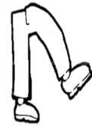
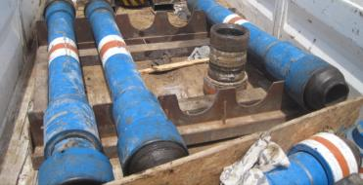
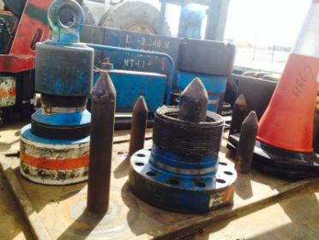
PDO Safety Advice
Use this Alert: Discuss in Tool Box Talks and HSE Meetings ➔ Distribute to contractors ➔ Post on HSE Notice Boards ➔ Include in site HSE Induction
Date: 30/03/2014.
Injury : Fractured wrist
What happened?
A 12” crossover was placed vertically on a Tubular rack on the HIAB truck. In order to protect the threads of the Crossover from getting damage during travelling, the Driver attempted to push the crossover into a horizontal position with his left foot while standing with his right foot on the lubricator and holding the side gate of the HIAB truck. During this attempt, his right foot slipped from the lubricator, causing him to fall and hit his left wrist on another lubricator resulted in a hairline fracture.
Your learning from this incident.
Always ensure proper loading on the back of the truck
Assess the risk and plan the activity
Ensure TBT captures all tasks related to the activity
Don’t use shortcuts to finish your task.
Do not stand on the tools.
Provide proper storage rack for Cross overs.
Contact: MSE54 for further information or visit the HSE Website Learning No 13 30/03/2014

Slide 2
Management learning's
Use this Alert: Distribute to contractors ➔ Discuss in Meetings
Date: 30/03/2014.
Injury : Fractured wrist
As a learning from this incident and ensure continual improvement all contract
managers are to review their HSE HEMP against the questions asked below
Confirm the following:
1-Do you conduct a task specific TBT?
2-Do you provide a proper cross over stand when required?
3-Do you have equipment specific loading procedure?
4-Is the storage provision on your transporting vehicles slip & trip hazards free?
5-Do you consider MOC when truck capacity or tool size are changed for transporting?
6-Do you have a system to ensure actions from lateral Learnings are implemented?
7-Is the alert/learning advice understood by the crew members?
Contact: MSE54 for further information or visit the HSE Website Learning No 13 30/03/2014

