Slide 1
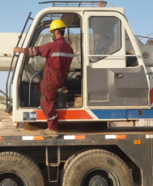
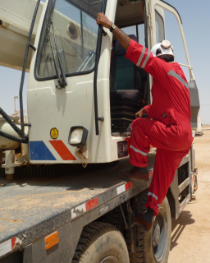
PDO Safety Advice
Use this Alert: Discuss in Tool Box Talks and HSE Meetings ➔ Distribute to contractors ➔ Post on HSE Notice Boards ➔ Include in site HSE Induction
Date: 02/04/14
Injury: Fractured wrist
What happened?
While coming down from the crane operating cabin to approach the crane driving cabin, the Crane Operator left foot slipped from the crane platform, just below the cabin. He lost his balance and fell on to the ground, with his body weight on to his left hand.
Your learning from this incident..
Maintain crane platform cleanness from greasiness to avoid slips.
Watch your steps while ascending/descending and do it slowly and carefully.
Holding only one hand on the handle support & foot at the edge of platform
Apply 3 point contact while ascending/ descending for proper stability
Contact: MSE54 for further information or visit the HSE Website Learning No14 02/04/2014

Slide 2
Management learning's
Use this Alert: Distribute to contractors ➔ Discuss in Meetings
Date: 02/04/14
Injury: fractured wrist
As a learning from this incident and ensure continual improvement all contract
managers are to review their HSE HEMP against the questions asked below
Confirm the following:
Did you identify all possible hazards, risks and controls related to crane operator’s safety, are they part of TBT, TRIC and JSA?
  Did your hazard hunt / Safety behavior tour capture the hazards and risks related to the crane while ascending and descending?
  Do you have a system to ensure actions from lateral Learnings are implemented?
  Is the alert/learning advice understood by the crew members?
Contact: MSE54 for further information or visit the HSE Website Learning No14 02/04/2014

