Slide 1
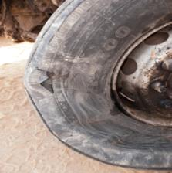
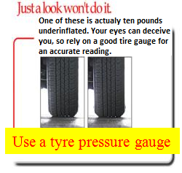
PDO Safety Advice
Use this Alert: Discuss in Tool Box Talks and HSE Meetings ➔ Distribute to contractors ➔ Post on HSE Notice Boards ➔ Include in site HSE Induction
Date: 27.02.2014
Injury: Multiple 3rd Party fatality, Motor Vehicle collision incident
What happened?
A prime mover and trailer was travelling towards Nimr, when the front driver side tyre blew out causing the vehicle to veer left across the carriageway into the path of an oncoming 3rd party light vehicle that was travelling in the opposite direction. Despite both drivers taking evasive actions, the two vehicles were unable to avoid each other and collided, tragically resulting in fatal injuries to the driver and passenger of the 3rd party vehicle.
Your learning from this incident..
Check regularly before long journeys, or during journeys if you feel any vibration through steering wheel stop and check:
Tyre pressures (note: tyre must be cold when being checked)
For any damage or increased temperatures
Signs of uneven wear
Check your tyre pressure and condition regularly
Contact: MSE54 for further information or visit the HSE Website Learning No 16 27/02/2014

Slide 2
Management learning's
Use this Alert: Distribute to contractors ➔ Discuss in Meetings
Date: 27.02.2014
Injury: Multiple 3rd Party fatality, Motor Vehicle collision incident
As a learning from this incident and ensure continual improvement all contract
managers are to review their HSE HEMP against the questions asked below
Confirm the following:
Do you select the correct type of tyre for your operations?
Does your tyre selection comply with SP 2000?
Do you have a robust maintenance procedure, that includes tyre inspection and maintenance?
Do your drivers conduct regular checks of their vehicle, including tyre pressures?
Do your drivers have the relevant training required as per SP2000?
Do you have a system to ensure actions from lateral Learnings are implemented?
Is the alert/learning advice understood by the crew members?
Contact: MSE54 for further information or visit the HSE Website Learning No 16 27/02/2014

