Slide 1
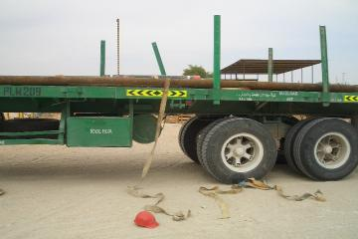


PDO Safety Advice
Use this Alert: Discuss in Tool Box Talks and HSE Meetings ➔ Distribute to contractors ➔ Post on HSE Notice Boards ➔ Include in site HSE Induction
Date: 13.03.2014
Injury: Dislocated right elbow & fractured forearm
What happened?
A 3rd party driver delivered material at the Completion Workshop. The forklift operator offloaded the Tubing hanger and x-mass tree. In order to secure the remaining loads with belt/latch, the driver had to get onto the trailer bed, while attempting to tighten the belt/latch, the tubing rolled and the driver lost his balance and fell to the ground causing injury to his right elbow and forearm.
Your learning from this incident..
Adhere to the SP2001 load restrain specification and guidance.
Do not stand on the tubing while securing the load.
Always have a safe body posture for the task your executing
Avoid being on the on top of the load during securing process.
Always exercise “Empowerment to STOP unsafe work”.
Always discuss the task hazards, risk and control in your TBT and TRIC prior the job
Photo explaining what was done wrong
Photo explaining how it should be done right
Never stand on top of unsecured loads
Contact: MSE54 for further information or visit the HSE Website Learning No 17 13/03/2014

Slide 2
Management learning's
Use this Alert: Distribute to contractors ➔ Discuss in Meetings
Date: 13.03.2014
Injury: Dislocated right elbow & fractured forearm
As a learning from this incident and ensure continual improvement all contract
managers are to review their HSE HEMP against the questions asked below
Confirm the following:
  Do you have a system in your organization to check 3rd party employees training compliance ?
  Does your loading & restraining process comply with SP 2001?
  Do you supervise all 3rd party activities on your site?
  Do you encourage your employees to exercise “Empowerment to STOP Unsafe Work”?
  Do you have a system to ensure actions from lateral Learnings are implemented?
  Is the alert/learning advice understood by the crew members?
Contact: MSE54 for further information or visit the HSE Website Learning No 17 13/03/2014

