Slide 1
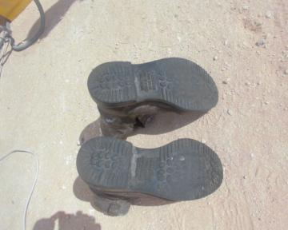
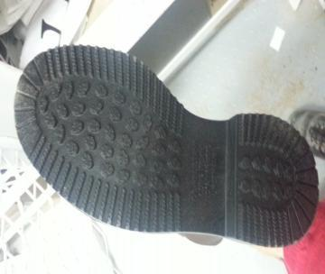
PDO Safety Advice
Use this Alert: Discuss in Tool Box Talks and HSE Meetings ➔ Distribute to contractors ➔ Post on HSE Notice Boards ➔ Include in site HSE Induction
Date: 06.04.14
Injury: Fractured ankle
What happened?
The rig Tool pusher approached the rig floor and moved towards the stand pipe manifold to observe shakers from the rig floor. Whilst walking he passed the rotary table, and slipped on the rig and fell down, resulting in an injury to his right ankle
Your learning from this incident..
Always check your safety shoes condition and make ensure their fit for purpose and working environment
Inspect your safety shoes for any damages or worn out sole and get it immediately replaced
Do not rush always watch out your step for slips, falls and trip hazards
Pay attention and be more cautious while approaching slippery surface
Partially worn out Red wing safety shoes used by the IP
Photo explaining what was done wrong
Safety shoes sole with proper grip
Check your safety shoes condition, and make sure there fit for purpose
Contact: MSE54 for further information or visit the HSE Website Learning No 20 06/04/2014

Slide 2
Management learning's
Use this Alert: Distribute to contractors ➔ Discuss in Meetings
Date: 06.04.14
Injury: Fractured ankle
As a learning from this incident and ensure continual improvement all contract
managers are to review their HSE HEMP against the questions asked below
Confirm the following:
  Do you have a system in place to ensure that all your employee are using appropriate PPE for the task/working environment?
  Do you have a system in place to monitor your employee PPE condition and replacement?
  Do you ensure slip, falls and trip hazards/risks and controls are covered effectively in TBT, TRIC and JSA ?
  Do you have anti-slip mats and checkered plates appropriate fixed in good condition where applicable?
  Do you chose your operation safety shoes base on your work environment and risk base factors?
  Do you have a system to ensure actions from lateral Learnings are implemented?
  Is the alert/learning advice understood by the crew members?
Contact: MSE54 for further information or visit the HSE Website Learning No 20 06/04/2014

