Slide 1

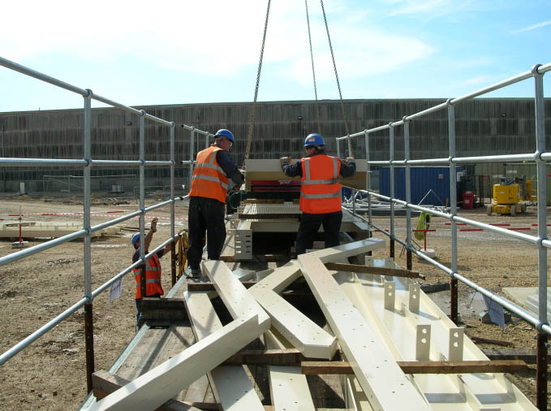
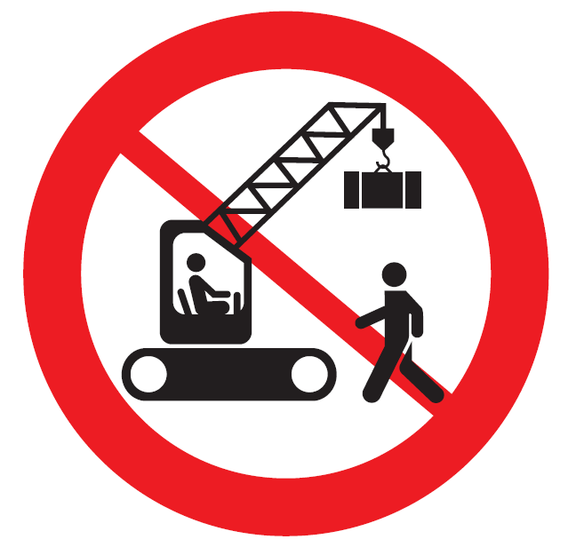
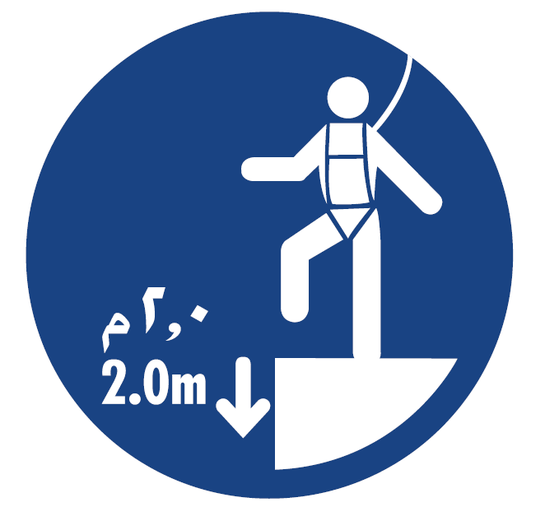
Safety Alert
Use this Alert: Discuss in Tool Box Talks and HSE Meetings ➔ Distribute to contractors ➔ Post on HSE Notice Boards ➔ Include in site HSE Induction
A recent global alert sent from Halliburton is a timely reminder of the importance of routine lifting and offloading practices. In this particular case a driver was severely injured when a pipe was dropped during unloading with a fork lift truck. A number of lessons learned were stated but the most important is keeping the lifting area clear of personnel when the lift commences.
We all need to remember:
  the importance of keeping persons out of the lift area whilst lifting operations are taking place.
  All riggers and banksmen, tag line personnel and drivers need to be aware of the safe positions before and during the mechanical lift
  Plan the lift (use the 10 point safety check list)
  Conduct the Tool Box talk, use pictures or demonstrate
  to ensure all personnel understand the basic rules
IF IN DOUBT…STOP THE WORK
AND CHECK IT OUT!

Slide 2
Safety Alert
10 point Safety check list for a Safe Lift (PR 1709*)
  1. Is everyone aware of and do they fully understand the lifting and hoisting procedures applicable to the lift?
  2. Has everyone attended the toolbox talk?
  3. Has a pre-use inspection of the Lifting Equipment been carried out and are the Lifting Accessories tagged or marked with:
  - Safe Working Load
  - A unique identification number
  - A valid certification date
  4. Are all safety devices working?
  5. Does everyone know the Person-in-Charge of the lift?
  6. Is everyone competent and aware of his or her tasks?
  7. Is there a current Lift Plan and JHA and does everybody understand the job and precautions?
  8. Does everyone know the environmental limits (e.g. maximum permissible wind speed) for the lift?
  Is the lift area controlled and is everyone clear if the load falls or swings?
  Are signaling methods and communication agreed and clear to you?
* PR-1709 - Lifting and Hoisting Procedure Lift Planning Execution

