Slide 1

Road Safety during Eid Holidays
2014
As a driver you have both a legal and moral responsibility towards yourself, your passengers and other road users
Here are some tips to help you be safer on the road

Slide 2
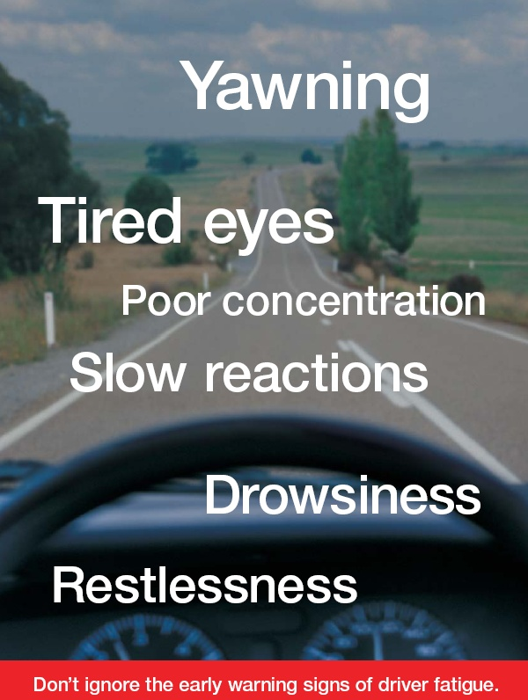
What is Fatigue?
FATIGUE: Mental or physical exhaustion that stops a person from being able to function normally.
Fatigue significantly reduces our ability to function safely and effectively.

Slide 3

Tips for Drivers
Daily solutions (Short Term)
  Scheduled breaks.
  Share the driving.
  STOP and nap if tired.
Long Term solutions
  Get adequate sleep the night before.
  Manage your sleep debt.
  Eat light meals, avoid fatty food during your journey.
Think of your family

Slide 4

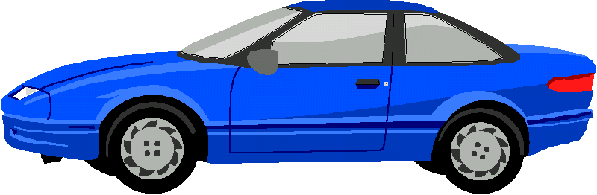


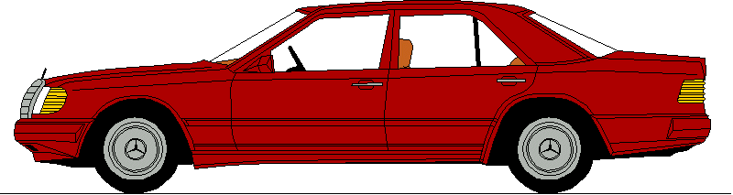
Traffic Congestion
What can you do as a driver to reduce your risk?
Leave extra time for your Journey during the holidays
Do not get upset with the bad driving behavior of other drivers- focus on your own driving
Do not over-speed - this will not shorten your journey but may shorten your life and the lives of others
Plan your journey to avoid peak times
Keep a safe distance at all times
Don’t get distracted by mobile phones or anything else.
While Driving
3 – Second gap
When Stopping
Be able to see the tyres and tarmac

Slide 5
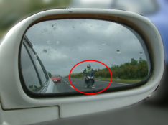
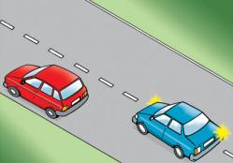
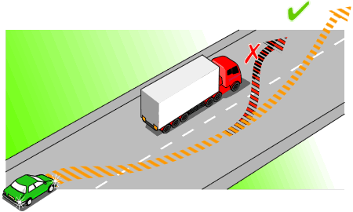
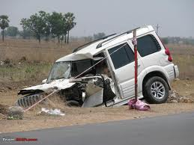
Overtaking
Ask yourself these questions before you attempt an overtake
Is it safe?
Is it necessary?
If so, why?
What are the benefits of performing the overtake?
What are the risks? Is it worth overtaking unsafely?
If it is necessary to overtake please consider the following
Safe Distance
Looking Forward
Mirror check
Indicate your intentions
Shoulder Check
Mirror check
Check clearance
Shoulder check again
Maintain proper speed
Make the correct decision not your last one
Think of your passengers and family

Slide 6
Always keep calm
Reminder Driving Tips!
Causes of stress | Remedies
Behaviour of other drivers | Leave space and time, be tolerant and don’t get upset
Traffic congestion | Leave extra time for your journey
Passengers (Children) | Entertainment
Poor vehicle handling | Conduct pre journey checks
Weather conditions | Leave more time for your journey
Mobile phones | Switch off or keep them on silent mode
Running late | Leave more time for your journey, pull in and call to say you will be late
It is better to arrive late than not at all

Slide 7


Thank you
Remember to
Concentrate – focus on the job at hand which is driving
Stay calm – no situation is worth losing your life over
Be tolerant – other drivers will make mistakes
Drive at an appropriate speed for the conditions

