Slide 1
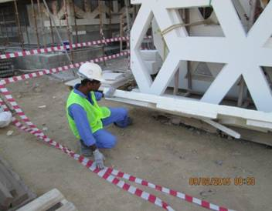
PDO Incident First Alert
Incident type | LTI(#05) | PIM ID | 1088499
Date/ time | 05/02/2015 (16:45 hrs) | Directorate
Location | Ras Al Hamra PDO school | Dept
What happened
A 44 year old mason was unloading glass reinforced concrete panels from a trailer and onto a trestle when one of the panels inadvertently fell towards him impacting on his left leg and shoulder resulting in a fracture to his left leg.
Mr. Musleh asks the questions of can it happen to you?
How do you make unstable objects stable?
How do you store tall items safely?
Are there enough of you to safely handle objects?
Always get out of the way of falling objects if you can.
HSE Team Leaders: Please disseminate this LTI notification to your teams.

