Slide 1
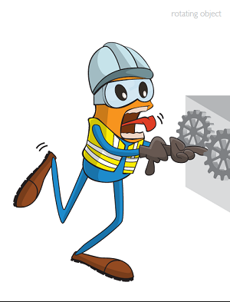
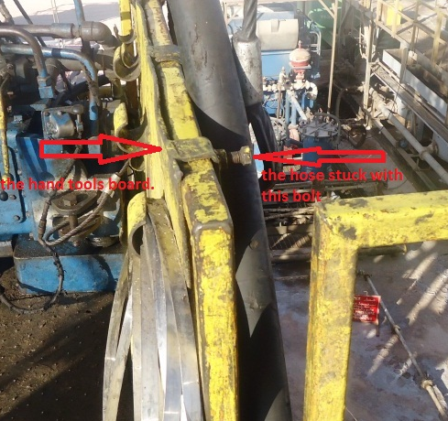
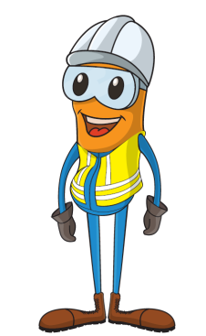
PDO Incident First Alert
Incident type | LTI(#02) | PIM ID | 1088282
Date/ time | 16/01/2015 (01:30hrs) | Directorate
Location | Hoist#3 Operating in Zauliyah | Dept
What happened
A 24 year old Omani roustabout fractured his right middle finger when he trapped his finger. The assistant driller was using a hoist to lift a Kelly hose but the hose snagged on a bolt securing the hand tools board. He reversed the hoist at the same time the roustabout tried to release the hose manually and his middle finger trapped against the hand tools board .
Can the task be done using ‘hands off’ principle?
Is communication between workers efficient?
Is the right person doing the right job?
Please disseminate this LTI notification to your teams and use it in your tool box talks and HSE meetings and notice boards.

