Slide 1
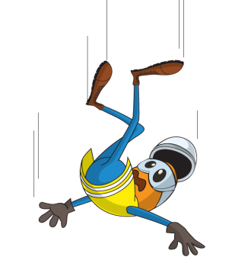
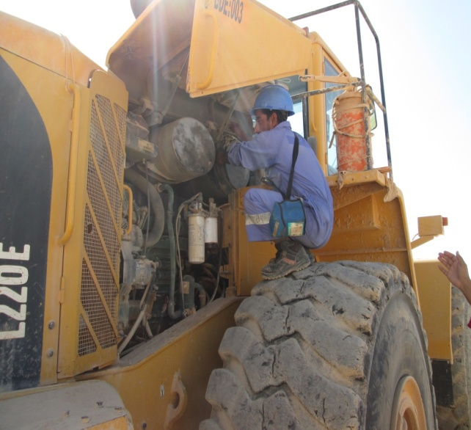

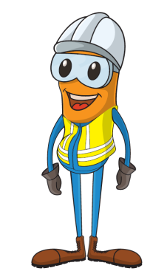

PDO Incident First Alert
Incident type | LTI (#03) | PIM ID | 1088467
Date/ time | 03/02/2015 (12:50 hrs) | Directorate
Location | Borrow – Pit 31 | Dept
What happened
A 30 year old operator was standing on top of a loader wheel changing an air filter when he lost his balance falling 1.5.m fracturing his right wrist.
Mr. Musleh asks the questions of can it happen to you?
Do you ever stand on a tyre to change the filter?
Who should change the filter and where?
How should the filter be changed safely?
What motivates people to work unprotected?
Do you access other locations you shouldn’t?
Please disseminate this LTI notification to your teams and use it in your tool box talks and HSE meetings and notice boards.

