Slide 1
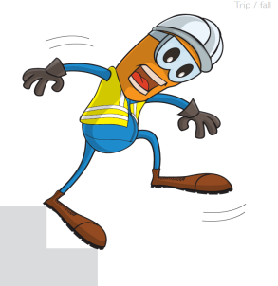
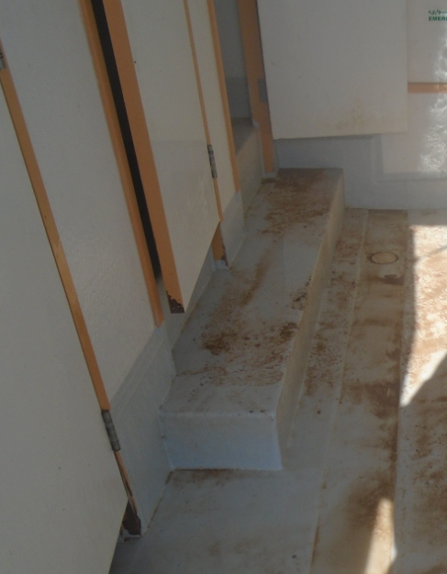
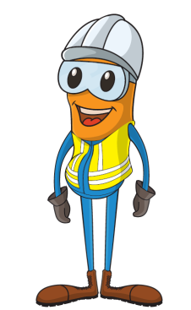
PDO Incident First Alert
Incident type | LTI(#01) | PIM ID | 1088254
Date/ time | 09/01/2015 (23:30hrs) | Directorate
Location | Rig 60- Yibal area | Dept
What happened
A floor man (23 year old) Omani lost his balance when exiting the toilet cubicle on the rig. He felt pain as he twisted his left knee but continued to work. The next day the pain was worse so he went to hospital. Initially they allowed him to return to work with light duties but a further examination 4 days later identified tear in his knee joint which required an operation.
step out
Are all floors clean and dry?
Does all your lighting work?
Do you notice workers suffering from fatigue?
Are your steps marked to identify them?
Please disseminate this LTI notification to your teams and use it in your tool box talks and HSE meetings and notice boards.

