Slide 1
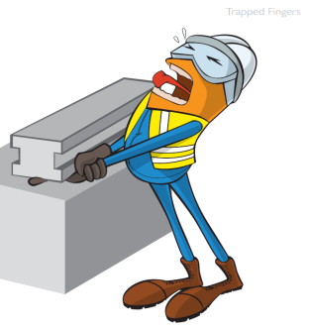
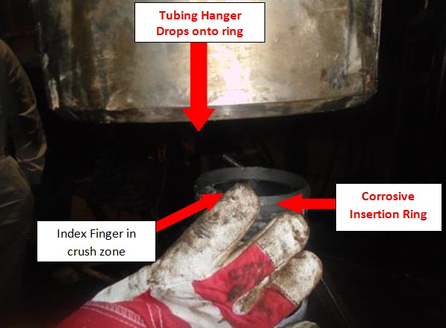
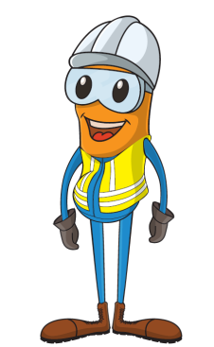
PDO Incident First Alert
Incident type | LTI(#06) | PIM ID | 1088547
Date/ time | 12/02/2015 (19:00 hrs) | Directorate
Location | Marmul | Dept
What happened
A 40 year old Well Head Technician (WHT) was manually aligning the corrosive insertion ring while instructing the Assistant Driller to lower the tubing hanger. As the hanger was lowered the WHT right index finger became trapped , he reacted by pulling the finger out causing the amputation of the finger tip exposing the bone.
Mr. Musleh asks the questions of can it happen to you?
Do you put your fingers in crush zones?
Do you take short cuts?
Can this task be done using ‘hand’s off’ principle?
Please disseminate this LTI notification to your teams and use it in your tool box talks and HSE meetings and notice boards.

