Slide 1
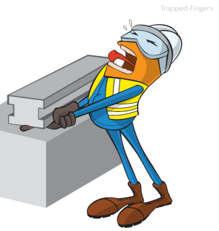
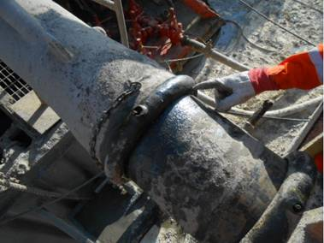
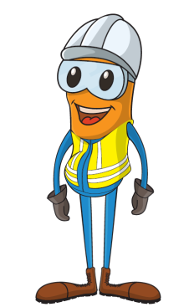

PDO Incident First Alert
Incident type | LTI(#07) | PIM ID | 1088671
Date/ time | 26/02/2015 (09:45 hrs) | Directorate
Location | Amin | Dept
What happened
A 32 year old derrick man had just fixed a small leak in a connection between the shale shaker pipe and the flow line (which was also connected to the BOP). He checked the size of the gap between the two pipes by sticking in his finger. Vibrations from the BOP caused a sudden movement in the pipes, the gap closed and his index finger was crushed.
Crush point
Mr. Musleh asks the questions of can it happen to you?
Do you put your fingers in crush zones?
Have you isolated all sources of energy?
Can this task be done using ‘hand’s off’ principle?
Please disseminate this LTI notification to your teams and use it in your tool box talks and HSE meetings and notice boards.

