Slide 1
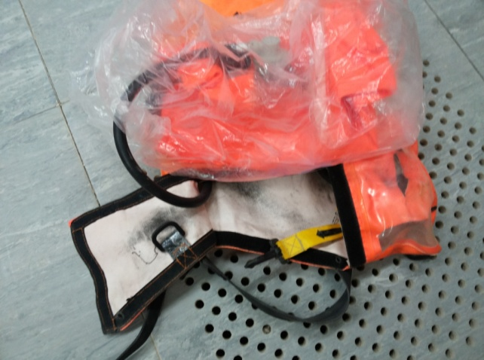
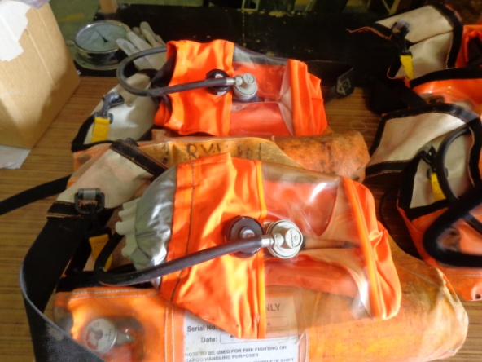
What happened?
A four man contractor maintenance crew were working inside a high risk sour facility with escape sets in an unsafe condition.
The automatic firing pins which activate the air-supply to the hood when the bag flaps are opened were found to be detached.
The face mask of several escape sets had also been covered in plastic wrapping which compromised the ease to put on the hoods quickly.
This intervention may have saved lives.
Your learning from this incident
  Check escape sets thoroughly before issue.
  Users should also test their escape sets prior to use.
  Keep escape sets maintained & free from obstructing materials.
  Automatic firing pins & quick fire strap must work.
  Substandard escape sets must never be used.
Plastic wrap
Detached Firing pin
Always ensure Safety Critical Life saving equipments are in ready to use condition.

