Slide 1
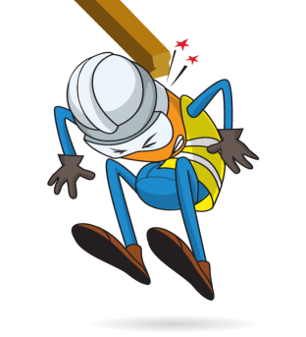
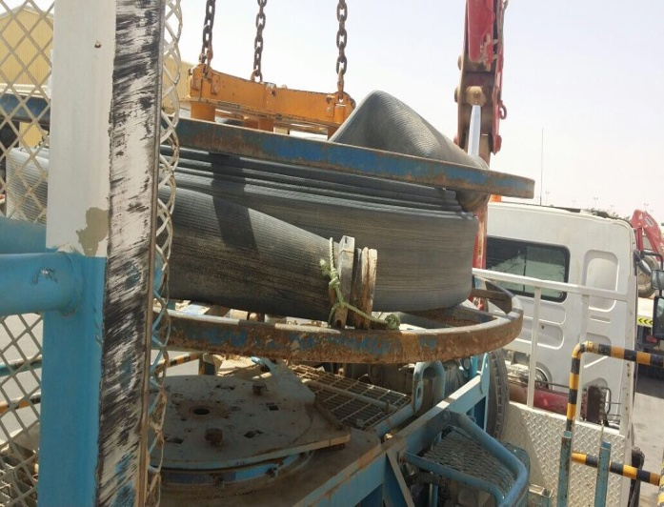

PDO Incident First Alert
Incident type | Fatality (#01) | PIM ID
Date/ time | 09/03/2015 (11:30 hrs) | Directorate
Location | Bahja | Dept
What happened
A 31 year old operator was laying out 6” flat rubber hoses which were coiled on a large horizontal reel on a hose deployment unit. The reel jammed as the last part of first hose was nearly uncoiled. The operator managed to free the reel but in doing so the motorised reel began rotating again uncoiling the last loop of the hose. This caused the metal coupling on the end of the hose to fly off the reel at speed and it hit the operators head, killing him.
Reel
Hoses metal Coupling
Ask your staff the questions of can it happen to you?
Do you ensure equipment is isolated before working on it?
Do you keep away from the line of fire from flying objects?
Do you always wear your PPE?
Do you always consider “what could go wrong?”
Please disseminate this LTI notification to your teams and use it in your tool box talks and HSE meetings and notice boards.

