Slide 1
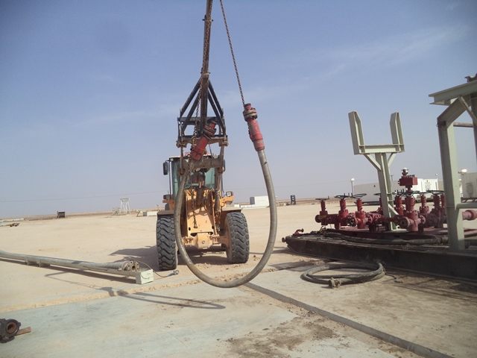
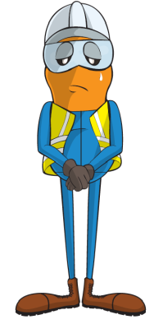
PDO Incident First Alert
Incident type | LTI(#10) | PIM ID | 1088916
Date/ time | 17/03/2015 (14:15 hrs) | Directorate
Location | Saih Nhada | Dept
What happened
A trainee assistant driller needed to move a hose to the inspection area and so he hooked it to the forklift using two chains connecting the boom to two end of the hose. The forklift drove to the inspection area and as it lowered the hose one of the chain hooks slipped causing the hose to fall and swing striking him on the foot causing a fracture.
Mr. Musleh asks the questions of can it happen to you?
How do you ensure security of the load?
Do you keep out of the lifting zone during lifting operations?
How do you protect people from the “Line of Fire”?
Please disseminate this LTI notification to your teams and use it in your tool box talks and HSE meetings and notice boards.

