Slide 1
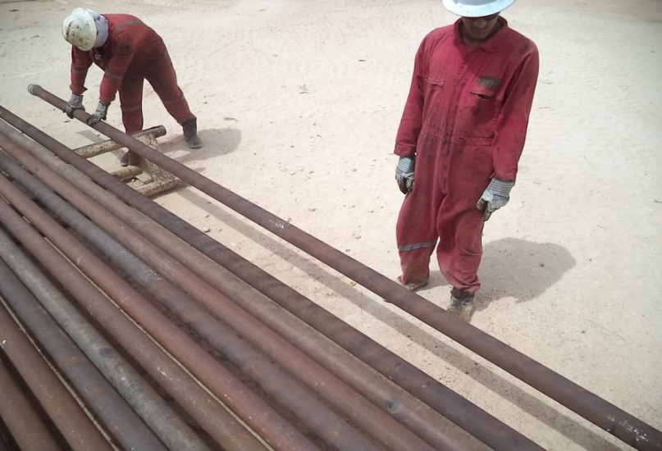
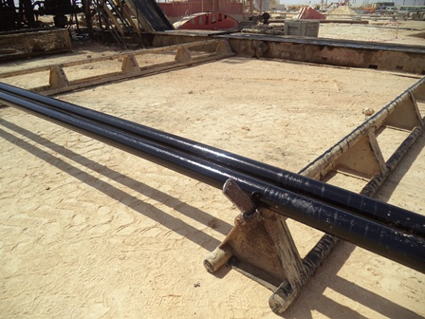
PDO Safety Advice
Use this Alert: Discuss in Tool Box Talks and HSE Meetings ➔ Distribute to contractors ➔ Post on HSE Notice Boards ➔ Include in site HSE Induction
Date: 07/07/2014
Injury: Broken toe
What happened?
The Pampa pump was pulled out of hole and laid on a pipe rack together with some 4½” tubing joints. The driller and hoist supervisor were inspecting the pump after the driller noticed that the pump had a small hole inside. The DSV asked the Driller to show him the hole in the pump. The Driller then rolled the pump assembly to identify the hole which caused a joint of 4½” tubing to roll to the edge of the pipe rack. Since the stoppers were not in place, the 4½”tubing fell from the edge of the pipe rack on the IP’s left foot breaking his toe.
Your learning from this incident..
Always ensure that the pipe racks have stoppers installed.
Always secure the tubes on pipe racks.
Stored energy! Always consider the possibility that equipment and pipe can drop, position yourself in a safe place.
Photo explaining what was done wrong
Photo explaining how it should be done right
All pipe racks must have stoppers installed.
Contact: MSE34 for further information Learning No 43 07/07/2014

Slide 2
Management learning's
Distribute to contractors ➔ Post on HSE Notice Boards
Date: 07/07/2014
Injury: Broken toe
As a learning from this incident and ensure continual improvement all contract
managers are to review their HSE HEMP against the questions asked below
Confirm the following:
Do you have a single point responsibility to ensure that all pipe racks have stoppers?
Do the supervisors give feedback on the STOP cards, hazard hunts and other HSE tools?
Do your site supervisors do dedicated HSE walkabouts on the location?
Contact: MSE54 for further information Learning No 43 07/07/2014

