Slide 1
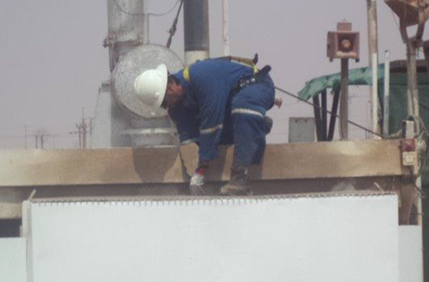
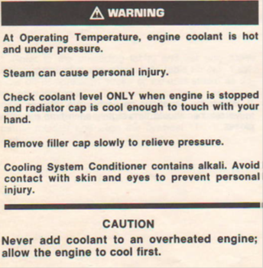
PDO Safety Advice
Use this Alert: Discuss in Tool Box Talks and HSE Meetings ➔ Distribute to contractors ➔ Post on HSE Notice Boards ➔ Include in site HSE Induction
Date: 13/07/2014
Injury: Burns
What happened?
While troubleshooting an overheated engine the Chief Mechanic instructed the rig mechanic (IP) to check the water level in the radiator prior giving sufficient time to cool down. While the IP was trying to open the radiator cap it suddenly opened and the hot water gushed out from the radiator on the mechanic’s left arm, thigh and leg resulting to 1st & 2nd degree burns.
.
Your learning from this incident..
Management of Change process to be followed whenever there is a change in the routine tasks.
Risk Control tools (PTW/MOC, JSA, TBT, ..etc.) to be put in place prior to commencing a non-routine task.
Always position yourself in manner that minimizing the exposure to any hazards.
Enforce the Empowerment to STOP and supervisors to listen to their subordinates..
Х
Never Open Radiator’s Cap when it is Overheated
√
When working with Radiators be aware of high temperature and trapped pressure.
Always Follow OEM Instructions
Contact: MSE34 for further information Learning No 44 13/07/2014

Slide 2
Management learning's
Distribute to contractors ➔ Post on HSE Notice Boards
As a learning from this incident and ensure continual improvement all contract
managers are to review their HSE HEMP against the questions asked below
Confirm the following:
Is the empowerment to stop process used effectively?
Is the alert/learning advice understood by the crew members?
Are the tools/equipment appropriate for the job?
Do your JSA’s/Procedures cover all risks and hazards?
Contact: MSE34 for further information Learning No 44 13/07/2014

