Slide 1
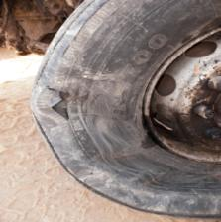
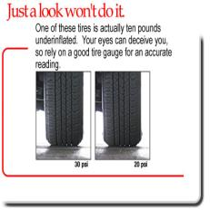
PDO Safety Advice
Use this Alert: Discuss in Tool Box Talks and HSE Meetings ➔ Distribute to contractors ➔ Post on HSE Notice Boards ➔ Include in site HSE Induction
Date: 13/07/2014
Injury: Fractured left wrist
What happened?
An OTO driver was driving from Muscat to Nimr when a tyre blew out and he lost control of the vehicle veering across the road into the desert and rolled over. The driver sustained a fracture to his left wrist.
Your learning from this incident..
Drivers
Stay alert, drive defensively, follow the training you have been given
Check your tyres for condition and pressure before starting your journey
Check the condition of the vehicle during rest breaks
Report to supervisors if tyres worn
Report and change tyres if more than 4 years old
Do not use re-tread tyres on the steering axle
Management
Conduct spot inspections / checks on your drivers
Ensure daily checks are conducted thoroughly
Make available tyre inflation equipments and gauges
Your eyes can deceive you so rely on a good tyre gauge for an accurate reading
Use a tyre pressure gauge
Stay alert, drive defensively, follow the training you have been given
Contact: MSE34 for further information Learning No 45 13/07/2014

Slide 2
Management learning's
Distribute to contractors ➔ Post on HSE Notice Boards
Date: 13/07/2014
Injury: Fracture left wrist
As a learning from this incident and ensure continual improvement all contract
managers are to review their HSE HEMP against the questions asked below
Confirm the following:
1 Do you conduct spot checks to ensure daily checks are conducted on vehicles before use?
2 Has it been briefed to drivers to check their vehicles during rest stops?
3 Is tyre inflation equipment and pressure gauges available to drivers at base location?
4 Do you ensure that all your vehicles tyres less than 4 years old?
5 Have you conducted an audit in the last year on your vehicle maintenance and safe driving procedures?
6 Do you select the correct type of tyre for your operations?
7 Does your tyre selection comply with SP 2000?
Contact: MSE34 for further information Learning No 45 13/07/2014

