Slide 1
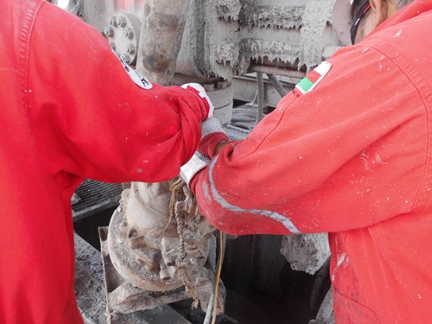
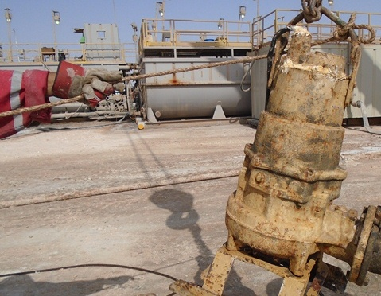

PDO Safety Advice
Use this Alert: Discuss in Tool Box Talks and HSE Meetings ➔ Distribute to contractors ➔ Post on HSE Notice Boards ➔ Include in site HSE Induction
Date: 20/07/2014
Injury: Finger fracture
What happened?
During preparation for a cement job, the IP and the Mud Tester attempted to install the Flight pump in the cellar using forklift boom. The area between the BOP and substructure is congested so the IP and Mud tester had difficulty installing the pump in the Cellar. As they maneuvered the Flight pump, the pump frame got stuck on the choke valve handle, the IP pulled the pump and at the same time Mud tester was pushing from the other side. When the pump released from the choke handle it swung toward the BOP’s and crushed the IP’s right hand ring finger.
Your learning from this incident.
Always identify the unsafe acts of your team and stop to correct them.
Plan the task and communicate hazards and risks before starting.
Re-Plan the task if new member join the task.
Always ensure that cellar area is free from debris
Always place your hands and fingers in safe position
Think about unwanted/unplanned energy releases .
Use hands off and avoid crush points
Contact: MSE34 for further information Learning No 46 20/07/2014

Slide 2
Management learning's
Distribute to contractors ➔ Post on HSE Notice Boards
Date: 20/07/2014
Injury: Finger fracture
As a learning from this incident and ensure continual improvement all contract
managers are to review their HSE HEMP against the questions asked below
Confirm the following:
1) Do you have the right screen protection on suction?
2) Do you keep a spare Flight pump installed in the cellar? If space allows?
3) Do you have JSA for installing / removing Flight pump in the cellar area?
Contact: MSE54 for further information Learning No 46 20/07/2014

