Slide 1
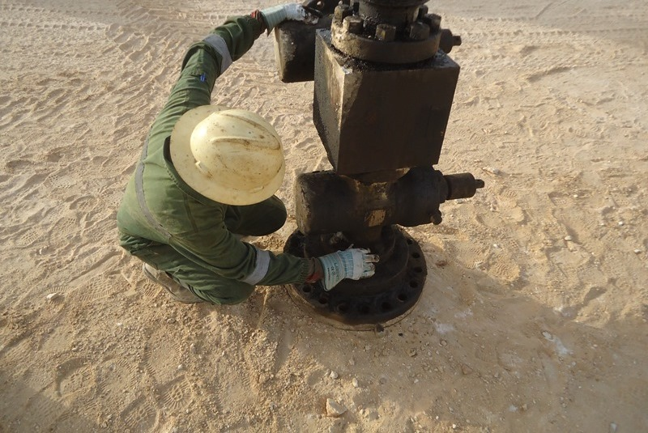
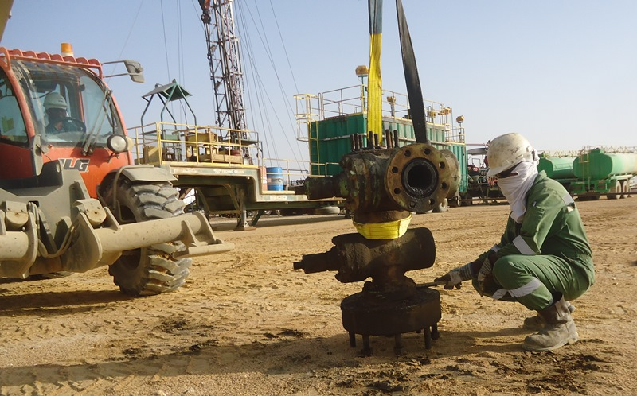
PDO Safety Advice
Use this Alert: Discuss in Tool Box Talks and HSE Meetings ➔ Distribute to contractors ➔ Post on HSE Notice Boards ➔ Include in site HSE Induction
Date: 22nd December 2014
Injury: Leg fracture
What Happened?
IP was cleaning the lower portion of the X-Mas tree in squatting position with the tree unsecured. After completing the cleaning of the lower portion IP tried to stand up taking the support of X-Mas tree which fell fracturing his right leg.
Learning from this incident:
Follow Procedures.
Think before acting to enable sound judgment.
Report all incidents diligently.
Secure heavy equipment like X-mas tree prior to handling
Contact: MSE34 for further information Learning No 48 22/12/2013

Slide 2
Management learning's
Distribute to contractors ➔ Post on HSE Notice Boards
Date: 22nd December 2014
Injury: Leg fracture
As a learning from this incident and ensure continual improvement all contract managers are to review their HSE HEMP against the questions asked below
Does your HEMP address the issue of securing heavy equipment like X-Mas tree prior to handling?
Are the crew actively practicing job planning and hazard identification?
Are all crew aware about effective supervision and leadership?
Are the Supervisors giving due importance to HSE during operations?
ARE THE PDO AND CONTRACTOR SUPERVISORS REPORTING ALL INCIDENTS DILIGENTLY?
Contact: MSE34 for further information Learning No 48 22/12/2013

