Slide 1
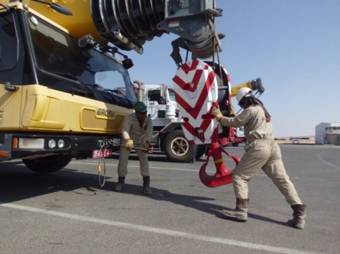
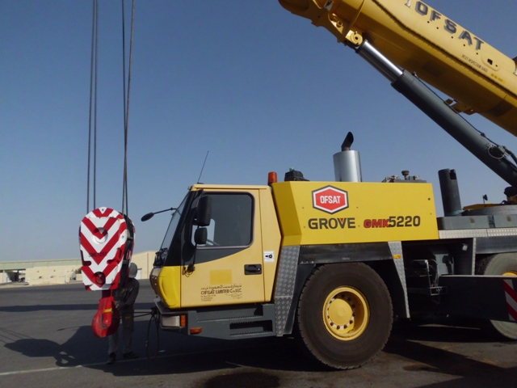
PDO Safety Advice
Use this Alert: Discuss in Tool Box Talks and HSE Meetings ➔ Distribute to contractors ➔ Post on HSE Notice Boards ➔ Include in site HSE Induction
Date: 29/09/2014
Injury : Finger fracture
What happened?
A crane operator injured his finger whilst attempting to secure the hook block assembly to the crane by taking a short cut. He lowered the boom and with the aid of another operator, swung the hook & block towards the front of the vehicle and attempted to attach the wire rope sling. Whilst trying to attach the wire rope sling he trapped his finger between the hook & the wire rope sling. Instead of following the procedure which is to, raise the boom & lowering the hook and block assembly to a position where the wire rope sling is easily attached to the hook with out manual handling hook block assembly.
Your learning from this incident..
The correct practice must be followed when attaching the hook & block to the crane.
Short cuts must not be taken
Operators should STOP work if something is unsafe
Follow the correct practice to secure the crane hook and block
Contact: MSE34 for further information Learning No 52 29/09/2014

Slide 2
Management learning's
Distribute to contractors ➔ Post on HSE Notice Boards
Date: 29/09/2014
Injury : Finger fracture
As a learning from this incident and ensure continual improvement all contract
managers are to review their HSE HEMP against the questions asked below
Confirm the following:
1 Are there correct procedures in place, and being followed?
Are crane safety procedures covered during TBT’s, prior to start of work?
Have your operators developed bad habits (to save time)?
Do your operators understand empowerment to STOP?
Do your operators utilize empowerment to STOP?
Does your company HEMP cover all areas of crane operation?
Is your company HEMP communicated to all employees?
Contact: MSE34 for further information Learning No 52 29/09/2014

