Slide 1
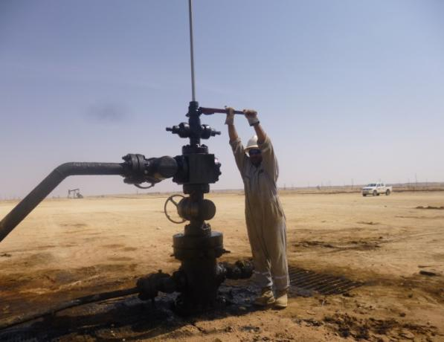
PDO Safety Advice
Use this Alert: Discuss in Tool Box Talks and HSE Meetings ➔ Distribute to contractors ➔ Post on HSE Notice Boards ➔ Include in site HSE Induction
Date: 26/10/2014
Injury: Fractured Left Elbow
What Happened?
IP was tightening the beam pump stuffing box using a 36” pipe wrench. The wrench slipped suddenly and the IP fell down landing on his left hand fracturing his left elbow.
Your learning from this incident..
Exercise empowerment to STOP work and Assess the risk
Use correct tools and technique for the job.
Report well site conditions prior to undertake the activity
Use working platform if working at height
Contact: MSE34 for further information Learning No 53 26/10/2014

Slide 2
Management learning's
Distribute to contractors ➔ Post on HSE Notice Boards
Date: 26/10/2014
Injury: Fractured Left Elbow
As a learning from this incident and ensure continual improvement all contract
managers are to review their HSE HEMP against the questions asked below
Confirm the following:
1 Does your HEMP cover working on high well heads?
2 Do you have a platform to work on elevated well heads?
3 How do you ensure the quality of TBT?
Contact: MSE34 for further information Learning No 53 26/10/2014

