Slide 1
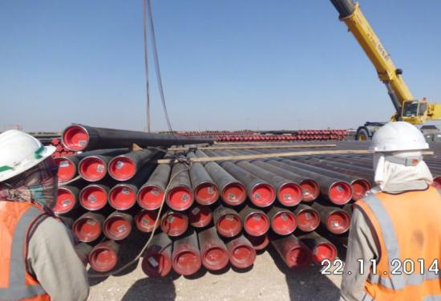
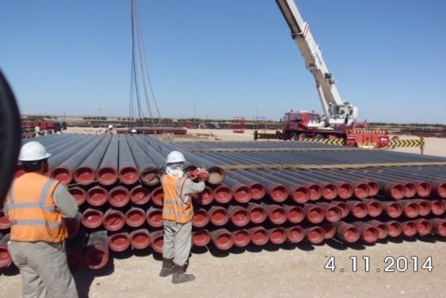
PDO Safety Advice
Use this Alert: Discuss in Tool Box Talks and HSE Meetings ➔ Distribute to contractors ➔ Post on HSE Notice Boards ➔ Include in site HSE Induction
Date : 25/10/2014
Injury: Fractured leg
What happened?
After offloading casing joints (4 at a time), off the truck on to the stack, the lifting hooks were taken off the casings, as the crane was winching in, ready to slew towards the truck for the next lift. The pelican hooks from the wire rope sling (4 x 4 with a single eye) caught on the underside of the casing joints and slide through until they caught on a piece of dunnage on the fourth layer of the stack, this caused one of the casing joints to lift and move, the IP, (who was stood on the stack), tried avoid the casing joint but couldn't, the casing joint struck the IP on his lower right leg.
Your learning from this incident..
The correct SOP must be followed for all tasks.
All workers should use their empowerment to stop if
something is unsafe
Crane operators should only take commands from trained and authorised banksman
Photo explaining what was done wrong
IP on Stack
Photo explaining how it should be done right
All crew members on ground
Don’t work on top of the pipe/casing stacks
Contact: MSE34 for further information Learning No 54 25/10/2014

Slide 2
Management learning's
Distribute to contractors ➔ Post on HSE Notice Boards
Date : 25/10/2014
Injury: Fractured leg
As a learning from this incident and ensure continual improvement all contract
managers are to review their HSE HEMP against the questions asked below
Confirm the following:
Are all your workers aware of their empowerment to stop?
Are all workers aware of the SOPs for their tasks?
Do you conduct suitable audits of you activities?
Are you sure that you have adequately identified all your work placed hazards?
Are your learning from incident briefings sufficient?
Contact: MSE34 for further information Learning No 54 25/10/2014

