Slide 1
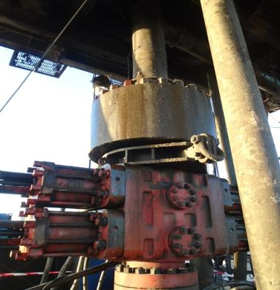

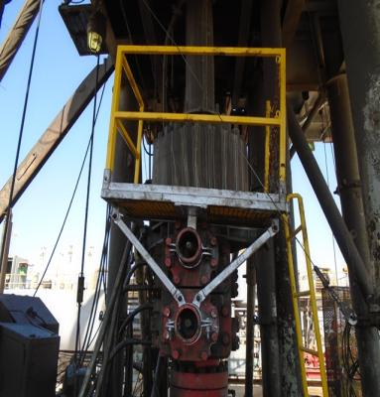
PDO Safety Advice
Use this Alert: Discuss in Tool Box Talks and HSE Meetings ➔ Distribute to contractors ➔ Post on HSE Notice Boards ➔ Include in site HSE Induction
Date: 04/11/2014
Injury: Cut wrist.
On 04th November 2014 IP (Derrick Man) was standing on top of BOP pipe ram bonnet to clean the bell nipple and he was holding hydrill with his left hand to balance him self while attempting to clean the bell nipple ring groove using high pressure wash gun with right hand.
IP pulled the trigger suddenly the gun swung towards his left hand as he lost his balance due to pressure at nozzle (220Bar) causing cut wound on IP’s left hand wrist.
Your learning from this incident.
  Ensure to have designed platform to clean around BOP area
  Ensure to have safe body position prior to start any job.
  Whenever in doubt stop and ask your supervisor.
✓
Always ensure stable body position and always hold wash gun with two hands
Contact: MSE34 for further information Learning No 54 04/11/2014

Slide 2
Management learning's
Distribute to contractors ➔ Post on HSE Notice Boards
Date: 04/11/2014
Injury: Cut wrist.
As a learning from this incident and ensure continual improvement all contract
managers are to review their HSE HEMP against the questions asked below
Confirm the following:
Do you have working platform around BOP area?
What is the normal practice to clean the BOP ring groove?
Are all crew members aware of the hazards of pressure cleaners?
What are the measures in place to control Risk associated with using high pressure wash gun?
Contact: MSE34 for further information Learning No 54 04/11/2014

