Slide 1
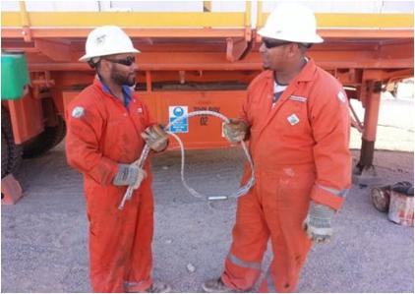
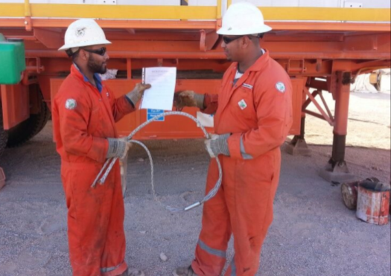
PDO safety advice
Use this Alert: Discuss in Tool Box Talks and HSE Meetings ➔ Distribute to contractors ➔ Post on HSE Notice Boards ➔ Include in site HSE Induction
Date : 08/12/2014
Injury: Broken Wrist
What happened?
The team connected the Sand Line (Wire Rope) to the Drill Line (Wire Rope) with a Snake Grip (Connection tool). The manufacturers instructions for the Snake Grip were available on site, but not used . They did not install the snake grip properly. The snake grip failed and an employee was hit by the falling Drill Line.
Your learning from this incident…
Never give a tool to someone without the manufacturer’s instructions.
Always read the instructions BEFORE you use a tool.
Always follow the manufacturer instructions.
Handover of Tools without Instructions
Handover of Tools with Instructions
Make sure you keep manufacturer instructions with the tool and use them.
1
Contact: MSE34 for further information Learning No 58 08/12/2014

Slide 2
Management learning's
Distribute to contractors ➔ Post on HSE Notice Boards
Date : 08/12/2014
Injury: Broken Wrist
As a learning from this incident and ensure continual improvement all contract
managers are to review their HSE HEMP against the questions asked below
Have you identified which tools need clear instructions?
Are the instructions available on site?
Have you trained your staff to ask for instructions or keep instructions with the tool?
Have you trained your staff to STOP work if they do not understand or know how to use a tool?
2
Contact: MSE34 for further information Learning No 58 08/12/2014

