Slide 1
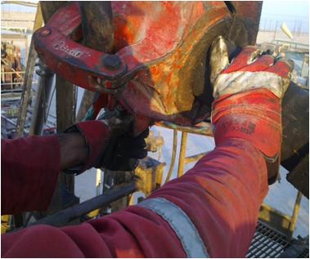
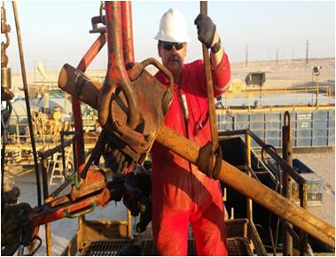
PDO safety advice
Use this Alert: Discuss in Tool Box Talks and HSE Meetings ➔ Distribute to contractors ➔ Post on HSE Notice Boards ➔ Include in site HSE Induction
Date : 19/12/2014
Injury: Finger Cut
What happened?
While POOH & L/D w/ TBG jnt 4-1/2” VTOP, during opening TBG Elevator IP placed his right hand on the body of TBG close to TBG Elevator. During opening, the elevator swing and trapped IP’s right hand index finger (which was positioned on tubing body) between the jaws of elevator and sustained a severe cut on his right hand index finger.
Your learning from this incident…
- Always posture your body against the Elevator so that you can open it by pulling the latch. Use One Hand only.
- Never place second Hand on the Tubular nor Elevator – it is HIGH pinch point Risk.
- Ensure hazards are identified for each activity and explained to crew to prevent such incident.
Ensure correct body posture prior to unlatch the elevator – use one hand only
Contact: MSE34 for further information Learning No 60 19/12/2014

Slide 2
Management learning's
Distribute to contractors ➔ Post on HSE Notice Boards
Date : 19/12/2014
Injury: Finger Cut
As a learning from this incident and ensure continual improvement all Contract Managers are to
Refer PDO HANDS & FINGERS Hazards book (Tools for Life) Lateral Learning package and
ensure against the questions asked below:
Does your standards/ procedures address the handling of elevator?
Is there is clear method of communication during operations on Rig floor?
Does your HSE MS address hazards and ergonomics? Are there any standards that you adhere to?
Are hazards identified?
Do you ensure HSE MS implementation.
Contact: MSE34 for further information Learning No 60 19/12/2014

