Slide 1
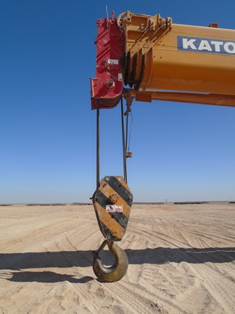
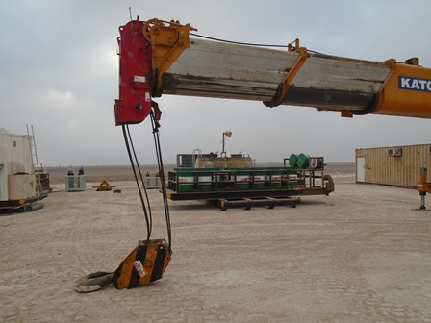
PDO safety advice
Use this Alert: Discuss in Tool Box Talks and HSE Meetings ➔ Distribute to contractors ➔ Post on HSE Notice Boards ➔ Include in site HSE Induction
Date:25/12/2014
Injury: Fractured fingers
What Happened?
Crane Operator noticed crane block was not coming down.
On inspection he found that the wire rope had come out off the boom sheave and was stuck, he then lowered the crane boom to correct the wire rope leaving hook block suspended 6 inches from ground.
The IP pulled stuck line, freeing wire rope from the sheave assembly which caused the suspended hook block to free fall due to loose spooled line on drum, catching two fingers of his right hand between block sheave and wire line.
Your learning from this incident.
Always identify the hazards of working area before starting the job.
Use hands off tools to correct lines on sheave
Always keep the hook block on the ground before working on the wire rope.
In case of doubt always consult with the mechanic (workshop)
Never place hand between sheave and wire lines
Contact: MSE34 for further information Learning No 62 25/12/2014

Slide 2
Management learning's
Distribute to contractors ➔ Post on HSE Notice Boards
Date:25/12/2014
Injury: Fractured fingers
As a learning from this incident and ensure continual improvement all contract
managers are to review their HSE HEMP against the questions asked below
Confirm the following:
How 3rd party defected tool/equipment are reported?
How do you train your crane operator to fix and damaged/stuck line?
How detailed is your crane checklist?
How you verify the quality of 3rd party inspection / maintenance?
Contact: MSE34 for further information Learning No 62 25/12/2014

