Slide 1
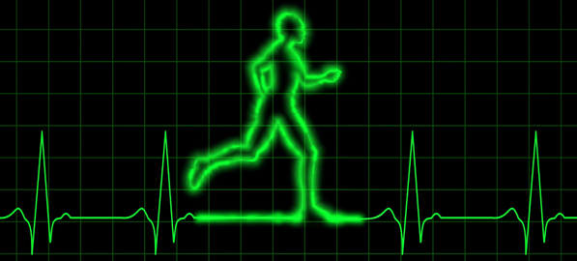
PDO Safety Advice
Use this Alert: Discuss in Tool Box Talks and HSE Meetings ➔ Distribute to contractors ➔ Post on HSE Notice Boards ➔ Include in site HSE Induction
Date: 21/02/2014
Non Accidental Death (NAD)
What happened?
A 45 yrs. old civil worker died of a heart attack whilst walking inside the camp during leisure time. Immediate Medical aid such as CPR, AED and Life Saving drugs could not revive him.
Your learning from this incident…
Avoid poor life style choices.
Walking daily for 30 mins could save your life.
Maintain a healthy & active life style
Contact: MSE54 for further information or visit the HSE Website Learning No22 21/02/2014

Slide 2
Management learning's
Use this Alert: Discuss in Tool Box Talks and HSE Meetings ➔ Distribute to contractors ➔ Post on HSE Notice Boards ➔ Include in site HSE Induction
Date: 21/02/2014
Non Accidental Death (NAD)
As a learning from this incident and ensure continual improvement all contract
managers are to review their HSE HEMP against the questions asked below
Do you run regular health and lifestyle campaigns?
Do you regularly monitor the health and fitness to work of your employees?
Contact: MSE54 for further information or visit the HSE Website Learning No22 21/02/2014

