Slide 1
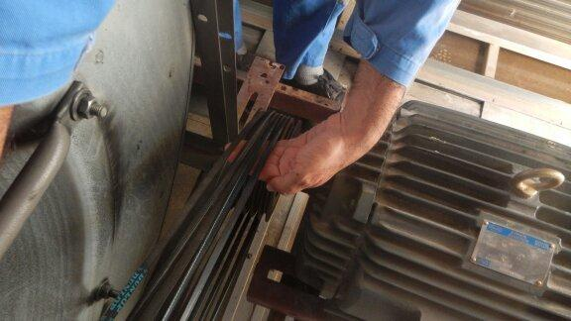
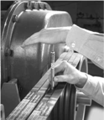
PDO Safety Advice
Use this Alert: Discuss in Tool Box Talks and HSE Meetings ➔ Distribute to contractors ➔ Post on HSE Notice Boards ➔ Include in site HSE Induction
Date: 07/05/2014
Injury: Fingers amputation and fracture
What happened?
Air Condition technician injured his fingers while trying to check the tension of the belts of Air Condition chiller unit. While doing that, the pulley rotated and trapped his left hand fingers between the belts and the pulley. This resulted to severe injury to his fingers.
Your learning from this incident:
Always ensure your hands and fingers are in a safe position & follow correct procedures when checking the belt tension by using a tensiometer.
Ensure all JHPs and TRICs cover all hazards specific to the job.
Always prioritize safety over schedule: never execute a job under time-pressure.
Keep your Hands and Fingers away of line of fire
Contact: MSE54 for further information or visit the HSE Website Learning No23 07/05/2014

Slide 2
Management learning's
Distribute to contractors ➔ Post on HSE Notice Boards
Date: 07/05/2014
Injury: Fingers amputation and fracture
As a learning from this incident and ensure continual improvement all contract
managers are to review their HSE HEMP against the questions asked below
Do your JHPs and TRICs cover all hazards specific to the job?
Do you always prioritize safety over schedule?
Do you ensure controls are in place when executing jobs under time-pressure?
Do you have a system to ensure actions from lateral Learnings are implemented?.
Is the alert/learning advice understood by the crew members?.
Contact: MSE54 for further information or visit the HSE Website Learning No23 07/05/2014

