Slide 1
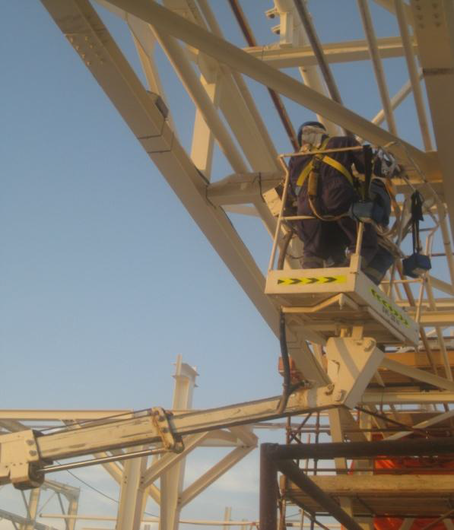
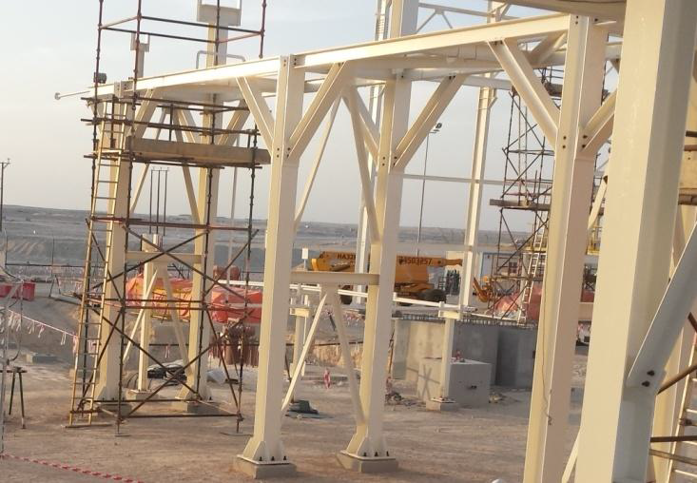
PDO Safety Advice
Use this Alert: Discuss in Tool Box Talks and HSE Meetings ➔ Distribute to contractors ➔ Post on HSE Notice Boards ➔ Include in site HSE Induction
Date : 04/03/2014
Injury: Rib Fracture
What happened?
A two man crew ( Rigger & Bucket Truck Operator) were asked to remove temporary wooden piping supports at a pipe rack using a handsaw. While attempting to position themselves within the bucket the control of the bucket, it was accidently engaged by a strap of the safety harness of the rigger. The bucket moved trapping the rigger between the guard rail of the bucket and the pipe rack structure, causing injury to rigger.
Your learning from this incident..
Ensure that bucket is in correct position
Ensure that you have enough room to move around in the bucket
Ensure an operation manual is available and understood
Always use the right means of access for working at heights jobs
Contact: MSE54 for further information or visit the HSE Website Learning No /0/2014

Slide 2
Management learning's
Distribute to contractors ➔ Post on HSE Notice Boards
Date : 04/03/2014
Injury: Rib Fracture
As a learning from this incident and ensure continual improvement all contract managers are to review their HSE HEMP against the questions asked below
Do you have a specific job risk assessments?
Are you sure the emergency lowering procedure is known and practiced?
Do you ensure that work at height policy is followed?
Do you have a system to ensure actions from lateral Learnings are implemented?
Is the alert/learning advice understood by the crew members?
Contact: MSE54 for further information or visit the HSE Website Learning No24 04/03/2014

