Slide 1
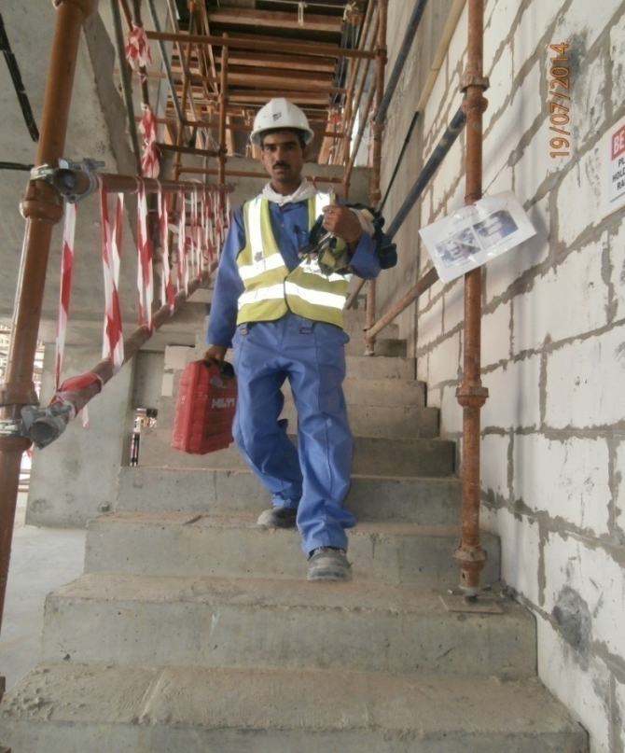
PDO Safety Advice
Use this Alert: Discuss in Tool Box Talks and HSE Meetings ➔ Distribute to contractors ➔ Post on HSE Notice Boards ➔ Include in site HSE Induction
Date: 25th May 2014
Injury: Elbow fracture
What happened?
While descending the last 2 steps to the ground floor
Administration block, IP slipped and fell on his left elbow. He was taken to the hospital where it was found that he had a fracture.
Your learning from this incident:
Always use handrail when ascending or descending stairs.
If carrying tools/materials keep one arm free while ascending or descending on stairs to ensure 3 points of contact.
Keep focusing on your steps while descending the stairs.
✗
Always keep one arm free while ascending or descending stairs
✓
Contact: MSE34 for further information or visit the HSE Website Learning No 28 25/05/2014

Slide 2
Management learning's
Distribute to contractors ➔ Post on HSE Notice Boards
Date: 25th May 2014
Injury: Elbow fracture
As a learning from the incident and to ensure continual improvement all managers are to review their HSE HEMP against the questions asked below
Are adequate handrails provided and demarcated in all access and egress?
Is communication of HEMP carried out effectively? Is it understood by all ?
Is the Golden rules, House rules and Life saving rules communicated effectively?
Do you have a system to ensure actions from lateral Learnings are implemented?
Is the alert/learning advice understood by the crew members?
Contact: MSE34 for further information or visit the HSE Website Learning No 28 25/05/2014

