Slide 1
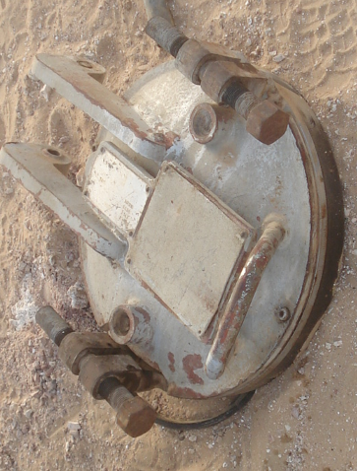
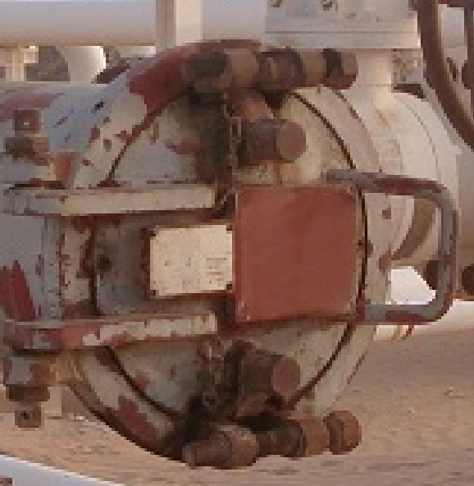
PDO Safety Advice
Use this Alert: Discuss in Tool Box Talks and HSE Meetings ➔ Distribute to contractors ➔ Post on HSE Notice Boards ➔ Include in site HSE Induction
Trap Door without Bleed Screws & Safety Lock
Date: 07.06.2014
Injury: Fractured wrist & arm
What happened?
Mechanical Crew foreman was performing a routine Trap Maintenance & Pig Launching activity on the 12” Yibal “B” to “A” gas line near the Yibal B station. When the crew were attempting to open the launcher door after de-pressurizing the line, the door swung open violently due to remnant pressure in the line and severely hits the foreman both hands. Two other crew member were sustained first aid injuries due to pressure release and due to glancing blow caused by detached door respectively.
Your learning from this incident..
Provide safe equipment for workforce.
Never attempt to perform the task when the facility or equipment is not
meeting with the standards.
Never attempt opening barrel door when bleed screws & safety interlock
are not present.
Never stand in the line of fire.
Trap Door with Bleed Screws & Safety Lock
COMPLY THE PROCEDURES-APPLY EMPOWERMENT TO STOP UNSAFE WORK.
Contact: MSE34 for further information or visit the HSE Website Learning No 29 07/06/2014

Slide 2
Management learning's
Distribute to contractors ➔ Post on HSE Notice Boards
Date: 07.06.2014
Injury: Fractured wrist & arm
As a learning from this incident and ensure continual improvement all contract
managers are to review their HSE HEMP against the questions asked below
Confirm the following:
Are your pig launchers and receivers having trap doors with bleed screws and safety interlock?
Are all your safety critical equipment installed as per applicable DEP?
Are your crew members aware of the procedure applicable for their activity?
Do you have a system to ensure actions from lateral Learnings are implemented?
Is the alert/learning advice understood by the crew members?
Contact: MSE34 for further information or visit the HSE Website Learning No 29 07/06/2014

