Slide 1
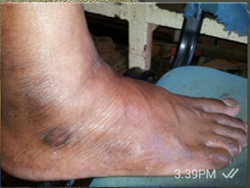
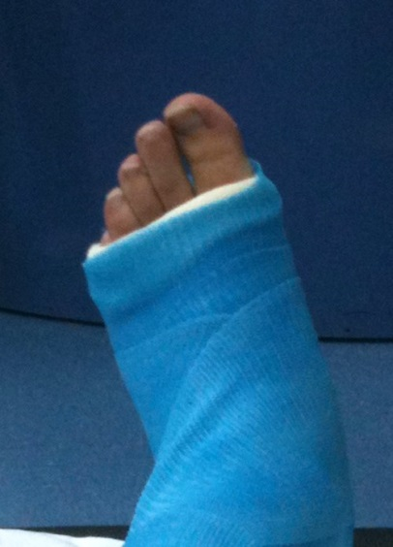
PDO Safety Advice
Use this Alert: Discuss in Tool Box Talks and HSE Meetings ➔ Distribute to contractors ➔ Post on HSE Notice Boards ➔ Include in site HSE Induction
Date : 22/01/2014
Injury: Broken foot
What happened?
An employee was draining the WPH waste water tank. Whilst laying the drainage pipe he lost balance and fell into the waste pit and broke his foot. The incident was described incorrectly to the PAC doctor. As a result, the injured person did not get the right medical treatment for 6 days.
Your learning from this incident…
If you hurt yourself make sure you report it immediately and correctly to your direct supervisor.
Don’t hide any injury happen to you so you can get the right treatment.
IP foot after incident
Foot after proper medical treatment (sample picture)
Always report all injuries immediately and correctly to make sure you get the right medical treatment as soon as possible
Contact: MSE54 for further information or visit the HSE Website Learning No21 22/01/2014

Slide 2
Management learning's
Distribute to contractors ➔ Post on HSE Notice Boards
Date : 22/01/2014
Injury: Broken foot
As a learning from this incident and ensure continual improvement all contract
managers are to review their HSE HEMP against the questions asked below
Do all your employees understand the importance and need to report every incident?
Are all your supervisors trained in incident investigation?
Are you supporting your teams / units in case they report an incident?
Are you investigating incidents properly? (No blame /No name /No shame?)
Do your supervisors understand potential consequences on “hiding” incidents?
Do you apply appropriate Consequences if incidents are not reported?
Contact: MSE54 for further information or visit the HSE Website Learning No21 22/01/2014

