Slide 1
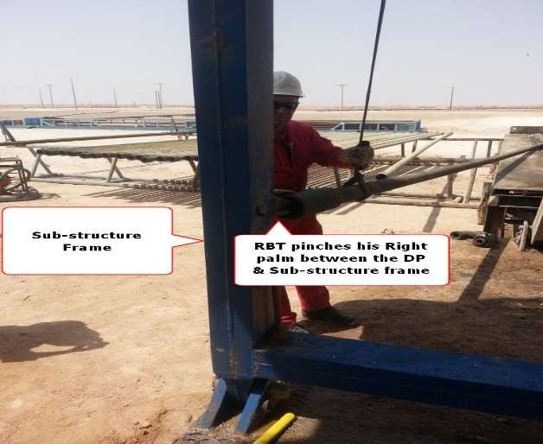
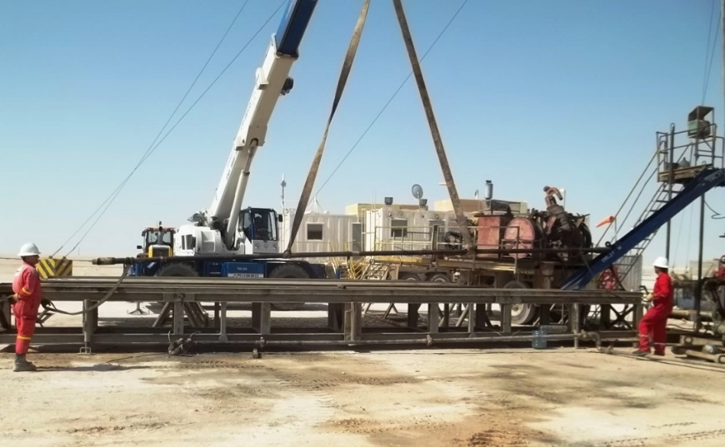
PDO Safety Advice
Use this Alert: Discuss in Tool Box Talks and HSE Meetings ➔ Distribute to contractors ➔ Post on HSE Notice Boards ➔ Include in site HSE Induction
Date: 10th August 2014
Injury: Fracture of little finger
What Happen:
While box end of DP got held up on work floor level, driller continued slackening the winch line. The Floorman pushed the DP down the V door with his leg causing the DP drifting out of V-Door and the Box end hanging close to the sub-structure beam .
As to recover the pipe, the Derrickman placed his right hand into the Box End and signaled the Floorman to pick up the DP. The DP lifted trapping the Derrickman fingers between the DP & substructure beam.
Learning from this incident:
Ensure adequate communication between crew involved in to the activity
Do not place hands at the pinch points, if possible do the task hands off
Ensure observing the job activity and proper supervision for all tasks
Ensure procedures being complied
Empowerment to stop
Ensure proper communication and do tasks hands off
where it is possible.
Contact: MSE34 for further information or visit the HSE Website Learning No29 10/08/2014

Slide 2
Management learning's
Distribute to contractors ➔ Post on HSE Notice Boards
Date: 10th August 2014
Injury: Fracture of little finger
As a learning from this incident and ensure continual improvement all Contract Managers are to review their HSE HEMP against the questions asked below:
Does your standards/ procedures address the handling of tubular during LD/ PU in detail ?
Is there a clear method of communication during operations on Rig floor?
Is there a clear method of recovering tubular when it is out side of V-door?
Does your HSE HEMP address hazards of not double wrapping tubular and dropped tubular?
Do you have a system to ensure actions from lateral Learnings are implemented?
Is the alert/learning advice understood by the crew members?
Contact: MSE34 for further information or visit the HSE Website Learning No29 10/08/2014

