Slide 1
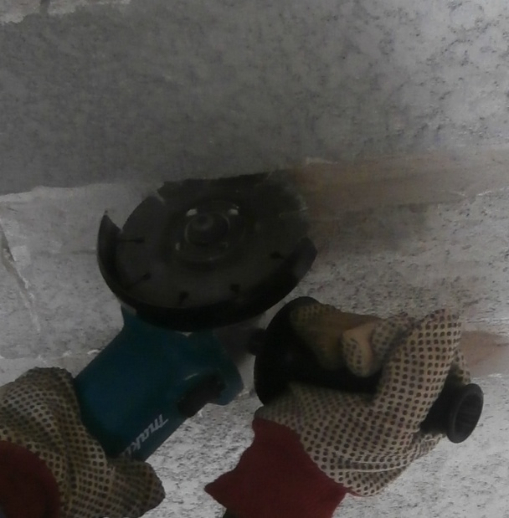
PDO Safety Advice
Use this Alert: Discuss in Tool Box Talks and HSE Meetings ➔ Distribute to contractors ➔ Post on HSE Notice Boards ➔ Include in site HSE Induction
Date: 8th June 2014
Injury: Deep cut
What happened?
While cutting horizontally for a wall chasing, the worker right hand index finger glove got entangled in the mesh inside the wall and he let go of the handle trying to extricate his glove. This caused his left hand to jerk away from the wall and the grinder to rotate , cutting his right dorsal (Back of Palm).
Your learning from this incident:
Be aware of any hazards present in the wall when grinding
Use the correct grip when holding a grinder
Do not operate any equipment unless authorized to do so
✗
✔
Do not use equipment unless authorized to do so
Contact: MSE34 for further information or visit the HSE Website Learning No 30 08/07/2014

Slide 2
Management learning's
Distribute to contractors ➔ Post on HSE Notice Boards
Date: 8th June 2014
Injury: Deep cut
As a learning from this incident and ensure continual improvement all contract
managers are to review their HSE HEMP against the questions asked below
Confirm the following:
Is the skills of the workers identified and communicated?
Is competent/authorized people doing the critical jobs?
Do you have a system to ensure actions from lateral Learnings are implemented?
Is the alert/learning advice understood by the crew members?
Contact: MSE34 for further information or visit the HSE Website Learning No 30 08/07/2014

