Slide 1
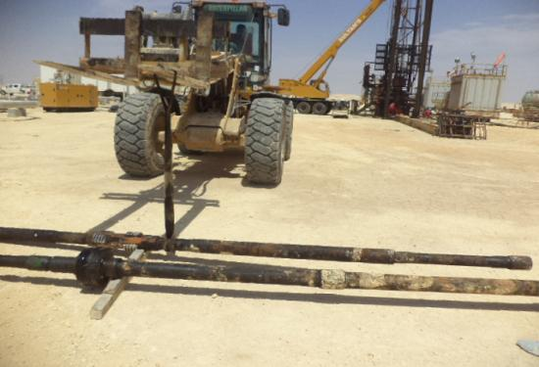
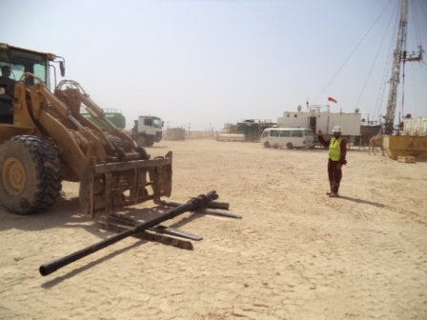
PDO Safety Advice
Use this Alert: Discuss in Tool Box Talks and HSE Meetings ➔ Distribute to contractors ➔ Post on HSE Notice Boards ➔ Include in site HSE Induction
Date: 26.04.2014
Injury: Broken left leg
What happened?
The crew used the forklift to move the 7” scraper assembly from the catwalk to place it at the edge of the location on the ground on top of wooden supports.
The A/D considered that another piece of wood was needed to be put under the 7” scraper to keep it off the ground and took the webbing sling from the F\L Operator. He wrapped one end of the sling around the pipe and hung the loop at the other end of the sling over the fork to lift the scraper.
When A/D attempted to get a second piece of wood, he tripped over the tubing hanger assembly that was behind him, lost his balance and when he tried to steady himself, pulled the sling off the fork. This resulted in his leg being trapped between the 7” scraper assembly (150 kg) and the hanger assembly while falling backwards.
Your learning from this incident..
Always use and apply PTW procedure correctly.
Always STOP the job if unsafe condition/act is observed.
Always supervisors are to supervise and not to perform the work.
Always follow correct practice to lift the load. (Comply with PR 1709)
Never use the web sling eye on the fork to lift a tubular, use the forks or attachment fitted.
Contact: MSE34 for further information or visit the HSE Website Learning No 27 26/04/2014

Slide 2
Management learning's
Distribute to contractors ➔ Post on HSE Notice Boards
Date: 26.04.2014
Injury: Broken left leg
As a learning from this incident and ensure continual improvement all contract
managers are to review their HSE HEMP against the questions asked below
Confirm the following:
Do all Supervisors correctly follow the requirements of the PTW system?
Do you have a designated CAP lifting person on location?
Is your supervisor working instead supervising?
Does your crew know when webbing sling can and cannot be used?
Do you have a system to ensure actions from lateral Learnings are implemented?
Is the alert/learning advice understood by the crew members?
Contact: MSE34 for further information or visit the HSE Website Learning No 27 26/04/2014

