Slide 1
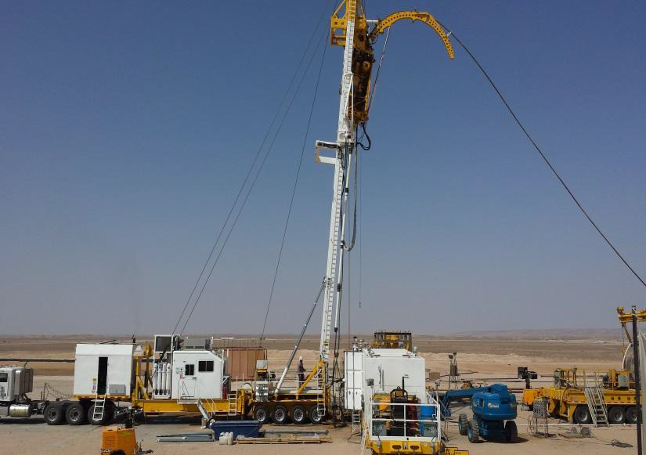
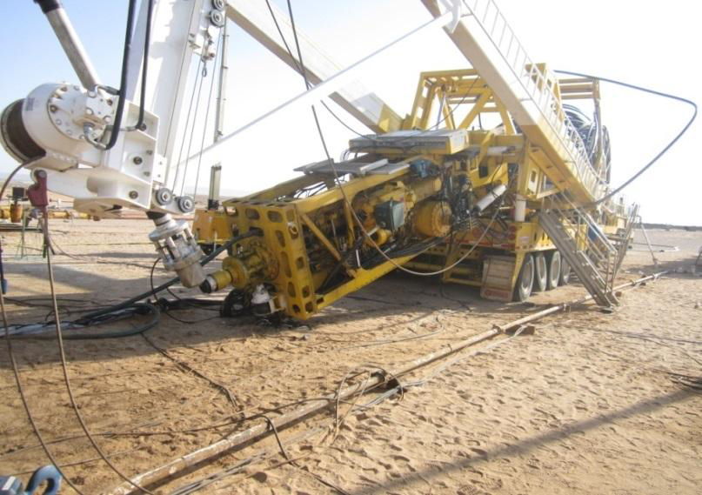
PDO Safety Advice
Use this Alert: Discuss in Tool Box Talks and HSE Meetings ➔ Distribute to contractors ➔ Post on HSE Notice Boards ➔ Include in site HSE Induction
Date:19/10/2013
Rig Mast Collapse
What happened?
Ct stopped at 4238mtbf to do a weight check. Started POOH with injector traction pressure of about 8,280 kPa. The system shutdown the injector because of drive speed error (injector chains were slipping). CT supervisor tried to increase the traction pressure but it went down sharply causing coil to run in hole at high uncontrolled speed (Run Away). Subsequently operator applied emergency brake and caused mast to collapse.
Your learning from this incident..
1.Supervisor failed to follow procedure (industry practice) for CT Run Away.
2.Do not apply reel brakes during run away
3.Do not panic in run away situation, take control of the scene.
Learnings:
Always follow CT Run Away procedures
Do not ignore warning systems!
Before
After
Do not apply Reel Brake emergency shut down in a Coiled tubing Run Away situation !
Contact: MSE54 for further information or visit the HSE Website Learning No21 19/10/2013

Slide 2
Management learning's
Use this Alert: Discuss in Tool Box Talks and HSE Meetings ➔ Distribute to contractors ➔ Post on HSE Notice Boards ➔ Include in site HSE Induction
Date:19/10/2013
Rig Mast Collapse
As a learning from this incident and ensure continual improvement all contract managers are to review their HSE HEMP against the questions asked below Confirm the following:
Contact: MSE54 for further information or visit the HSE Website Learning No21 19/10/2013

