Slide 1
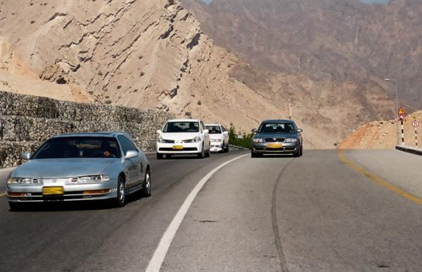

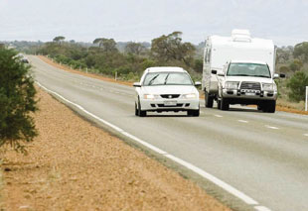

PDO Safety Advice
Use this Alert: Discuss in Tool Box Talks and HSE Meetings ➔ Distribute to contractors ➔ Post on HSE Notice Boards ➔ Include in site HSE Induction
Date: 12 Aug 2014
Injury: Fracture of toe of left foot
What happened?
A road traffic incident between private car and canter occurred at Nimr-Marmul blacktop road, on the “T” junction with Karim West graded road.
The private car applied brakes for about 62 m before impact and went under the Hino, forcing the canter to tilt over and landing on its right side.
Your learning from this incident..
When Turning left at a Junction ensure you check your left mirror before you turn.
The first danger to you is the traffic approaching from behind your left.
Ensure you apply your indicator before you turn.
Slow down before entering a junction.
Make sure you have 360 degree view
Contact: MSE34 for further information or visit the HSE Website Learning No 39 12/08/2014

Slide 2
Management learning's
Distribute to contractors ➔ Post on HSE Notice Boards
Date: 12 Aug 2014
Injury: Fracture of toe of left foot
As a learning from this incident and ensure continual improvement all contract
managers are to review their HSE HEMP against the questions asked below
Confirm the following:
Are all your drivers with Defensive Driving training and certified.
Are your drivers aware about additional hazards when driving: private cars, inexperienced drivers?
Are the drivers aware how to response in case of an emergency?
Do you have a system to ensure actions from lateral Learnings are implemented?
Is the alert/learning advice understood by the crew members?
Contact: MSE34 for further information or visit the HSE Website Learning No 39 12/08/2014

