Slide 1
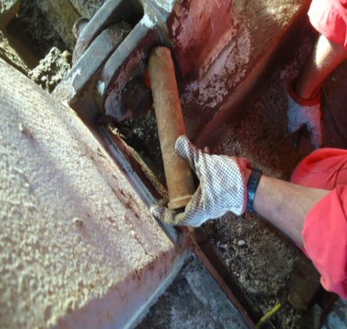

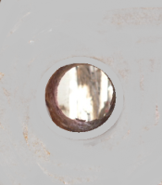
PDO Safety Advice
Use this Alert: Discuss in Tool Box Talks and HSE Meetings ➔ Distribute to contractors ➔ Post on HSE Notice Boards ➔ Include in site HSE Induction
The pad holes were not aligned before inserting the pin
Date: 20-08-2014
Injury:Left Hand finger tip amputated
What happened?
  Night Tool Pusher and the Derrick man were installing the off driller’s side pins with the help of two cranes, during the fixing of mud boat to the substructure. The tool pusher engaged the tapered portion of the pin in the lower pad eye hole with his left hand, in the sitting position and gave verbal signal to the truck pusher, to move the mud boat. While the crane slightly moved the mud boat, the pin also moved towards the substructure beam, resulting in left hand middle finger trapped between the head of the pin and the substructure beam.
Your learning from this incident..
Identify hazards and controls specific to the task
The JSPs/JSAs for the safe completion of task with “Hands Off” method, shall be strictly followed, where ever possible.
Align the pad holes properly before inserting the pin
Align the pad holes properly before inserting the pin
Supervisor shall supervise and
not directly do the task by himself
Identify and mark pinch point hazards
Contact: MSE34 for further information or visit the HSE Website Learning No 40 20/08/2014

Slide 2
Management learning's
Distribute to contractors ➔ Post on HSE Notice Boards
Date: 20-08-2014
Injury:Left Hand finger tip amputated
As a learning from this incident and ensure continual improvement all contract
managers are to review their HSE HEMP against the questions asked below
Confirm the following:
Do you have an effective program to address 4 Hand & Fingers Questionnaire before the task?
Do you have an adequate system to implement learning from incidents?
Do you have adequate protective equipment to prevent hands & Finger injuries?
Does your Supervisors set a good example and supervise the task effectively identifying the hazards and risks for the task?
Contact: MSE34 for further information or visit the HSE Website Learning No 40 20/08/2014

