Slide 1

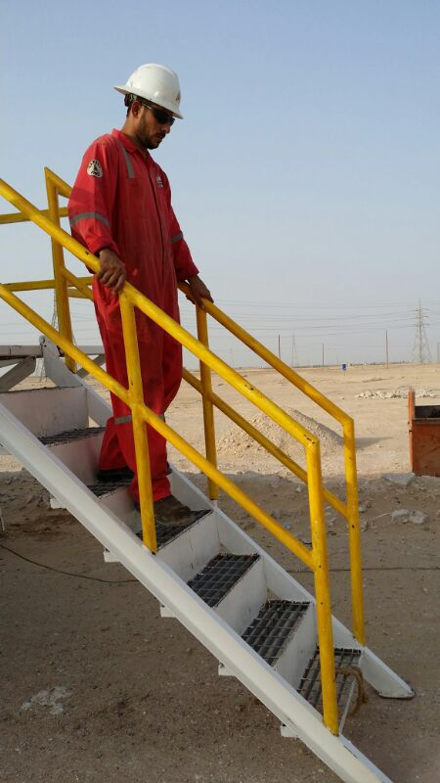
PDO Safety Advice
Use this Alert: Discuss in Tool Box Talks and HSE Meetings ➔ Distribute to contractors ➔ Post on HSE Notice Boards ➔ Include in site HSE Induction
Date:8/06/2014
Injury: Wrist fracture.
What’s happened:
The colleague was descending from a staircase when he slipped, fell & landed on his left hand causing an injury in his wrist and bruises in his right leg.
Your learning from this incident…
Slow down when descending from stairs.
Put handrails in both sides.
INTERVENE & STOP unsafe actions/ behaviors when observed.
Hold hand rails / Pay attention when you use the stairs.
Contact: MSE54 for further information or visit the HSE Website Learning No /0/2014

Slide 2
Management learning's
Distribute to contractors ➔ Post on HSE Notice Boards
Date:8/06/2014
Injury: Wrist fracture.
As a learning from this incident and ensure continual improvement all contract
managers are to review their HSE HEMP against the questions asked below
Confirm the following:
Have you audited the stair ways in all the operating units?
Is all personnel Stepping, Manual Handling and Lifting training up to date?
Are the crews performing daily and weekly hazard hunts?
Is a reward system in place for the best reports?
Is the reporting system clear to all site supervisors?
Do you have a system to ensure actions from lateral Learnings are implemented?.
Is the alert/learning advice understood by the crew members?.
Contact: MSE54 for further information or visit the HSE Website Learning No /0/2014

