Slide 1
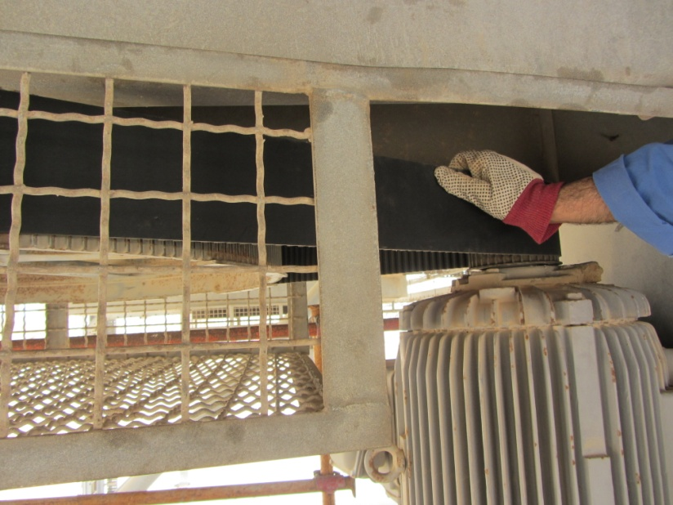
PDO Safety Advice
Use this Alert: Discuss in Tool Box Talks and HSE Meetings ➔ Distribute to contractors ➔ Post on HSE Notice Boards ➔ Include in site HSE Induction
Date: 16th June 2014
Injury: Finger fracture
What happened?
Colleague right hand little finger got trapped between gas cooling fan motor pulley and belt.
Your learning from this incident…
Always use a TRIC to assist YOU in hazards Identification.
Do not become complacent just because you have done the job before.
Watch you fingers carefully.
Always watch out for pinch points
Always Assess & Ensure a Through Hazard Identification before starting any job
Contact: MSE34 for further information or visit the HSE Website Learning No 42 16/06/2014

Slide 2
Management learning's
Distribute to contractors ➔ Post on HSE Notice Boards
Date: 16th June 2014
Injury: Finger fracture
As a learning from this incident and ensure continual improvement all contract managers are to review their HSE HEMP against the questions asked below
Do you have a specific risk assessment?
Do you have a system to ensure actions from lateral Learnings are implemented?.
Is the alert/learning advice understood by the crew members?.
Contact: MSE34 for further information or visit the HSE Website Learning No 42 16/06/2014

