Slide 1
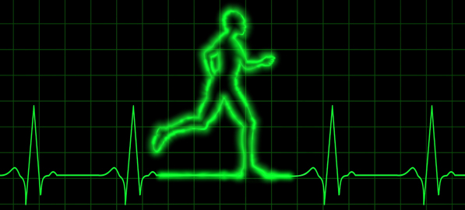
PDO Safety Advice
Use this Alert: Discuss in Tool Box Talks and HSE Meetings ➔ Distribute to contractors ➔ Post on HSE Notice Boards ➔ Include in site HSE Induction
Date: 07/02/2014
NAD
What happened?
An 54 year expatriate working as a Sr. Quantity Surveyor found unresponsive in his accommodation, could not be revived and died due to a heart attack ( myocardial infarction ).
Your learning:
Take chest pains as probable sign of heart disease. Always prioritise to get medical assistance as soon as possible .
CHEST PAIN IS NOT A TRIVIAL SIGN !!! GET MEDICAL ASSISTANCE ASAP
Contact: MSE54 for further information or visit the HSE Website Learning No13 07/02/2014

Slide 2
Management learning's
Use this Alert: Discuss in Tool Box Talks and HSE Meetings ➔ Distribute to contractors ➔ Post on HSE Notice Boards ➔ Include in site HSE Induction
Date: 07/02/2014
NAD
As a learning from this incident and ensure continual improvement all contract
managers are to review their HSE HEMP against the questions asked below
Contact: MSE54 for further information or visit the HSE Website Learning No13 07/02/2014

