Slide 1
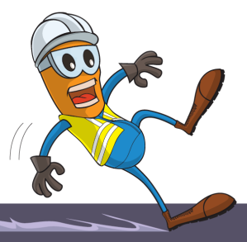
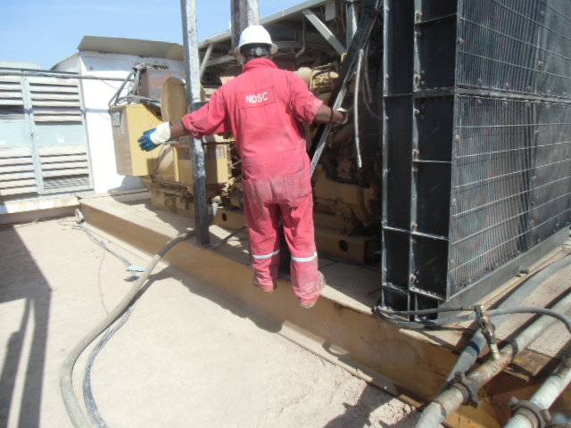
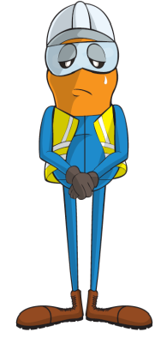
PDO Incident First Alert
Incident type | LTI(#11) | PIM ID | 1089061
Date/ time | 31/03/2015 (18:00 hrs) | Directorate
Location | Rig-88 - Sakhiya-30, Harweel area | Dept
What happened
During a routine inspection of a back up engine, the Chief Mechanic put his right foot on the skid 40 cm above ground and was holding the cross bar with his right hand. His right hand slipped from the cross bar and he lost his balance falling to the ground landing on his left hand fracturing his left wrist.
Hand position before loss of grip
Mr. Musleh asks the questions of can it happen to you?
40 cm
How do you ensure safe access and egress?
How do you ensure identification of all hazards associated with the task you are performing?
What checks do you carry out on new equipment?
Please disseminate this LTI notification to your teams and use it in your tool box talks and HSE meetings and notice boards.

