Slide 1
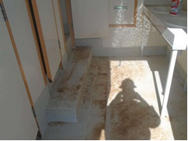
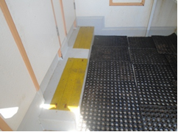
PDO Safety Advice
Use this Alert: Discuss in Tool Box Talks and HSE Meetings ➔ Distribute to contractors ➔ Post on HSE Notice Boards ➔ Include in site HSE Induction
Date: 09-01-2015
Injury: Left Knee fracture
What happened?
While the injured person (IP) was exiting the rig site bathroom stall, the IP slipped and fell causing him to twist and strike his left knee on the floor of the bathroom.
Your learning from this incident..
Make sure toilet facilities located at the rig and at camp sites have non-slip git based coatings applied to prevent slip hazards.
Accommodation units supplied as new for PDO Operations should have these coatings as standard. Pre-acceptance inspection checklist should be altered to reflect this requirement.
Bathroom floor at time of incident
Bathroom After Initial Corrective Action
Slippery surfaces – report & correct them
Contact: MSE34 for further information Learning No 01 09/01/2015

Slide 2
Management learning's
Distribute to contractors ➔ Post on HSE Notice Boards
Date: 09-01-2015
Injury: Left Knee fracture
As a learning from this incident and ensure continual improvement all contract
managers are to review their HSE HEMP against the questions asked below
Confirm the following:
Has all information been accurately communicated to workers involved in HSE activities?
Have appropriate audits and checks been conducted properly and have hazards identified been rectified in a timely manner?
Are Hazard Hunts being carried out regularly at both rig sites and camps and have hazards identified been rectified in a timely manner?
Contact: MSE34 for further information Learning No 01 09/01/2015

