Slide 1
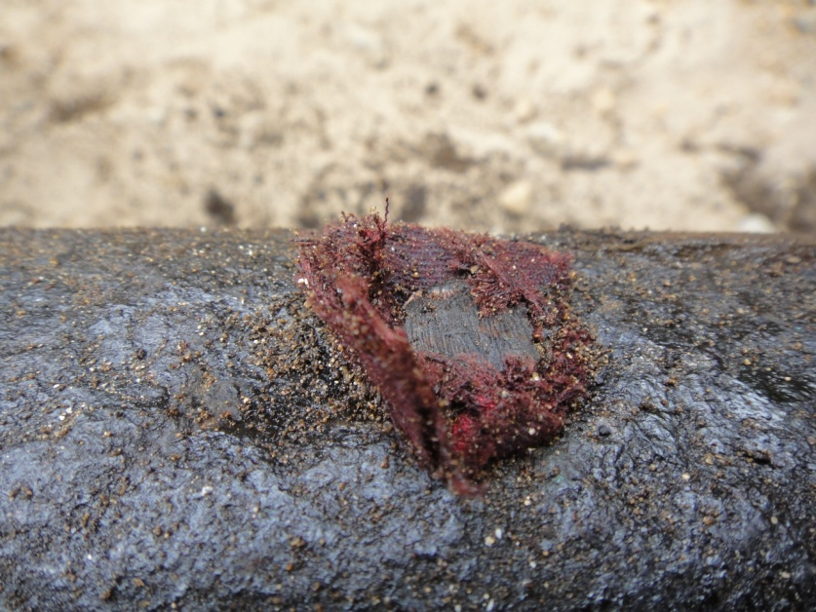
PDO Safety Advice
Use this Alert: Discuss in Tool Box Talks and HSE Meetings ➔ Distribute to contractors ➔ Post on HSE Notice Boards ➔ Include in site HSE Induction
Date: 12-01-2015
AI PSM (Tier 1)
What happened:
The MAF crude oil storage tank T-107 was lined up for loading. At 04:55 hrs, operator discovered a leak behind the Environment Treatment Plant (ETP) fence spraying from the ground. Due to the darkness and defective lights the wrong valve was isolated which delayed the correct isolation until 12 m3 of crude had been lost and it had flowed approx. 300m downhill.
Your learning from this incident..
Ensure above ground lines have not become buried
Ensure your inspections cover all your lines
Ensure any faulty equipment is repaired as soon as possible.
Question anything that you do not think is right.
You must understand the emergency response
Contact: MSE34 for further information Learning No 03 12/01/2015

Slide 2
Management learning's
Distribute to contractors ➔ Post on HSE Notice Boards
Date: 12-01-2015
AI PSM (Tier 1)
As a learning from this incident and ensure continual improvement all contract
managers are to review their HSE HEMP against the questions asked below
Confirm the following:
Are you sure your staff understand the emergency response required of them?
Are you sure your team do inspections periodically?
Is the alert/learning advice understood by the crew members?
Do you have a system to ensure actions from lateral Learning's are implemented.
Contact: MSE34 for further information Learning No 03 12/01/2015

