Slide 1
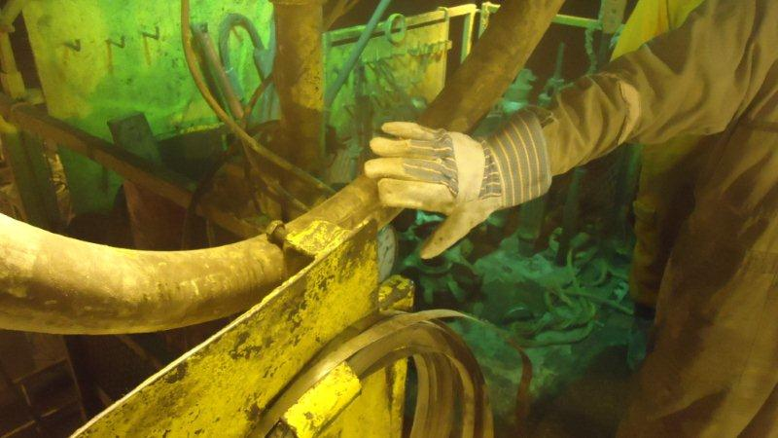
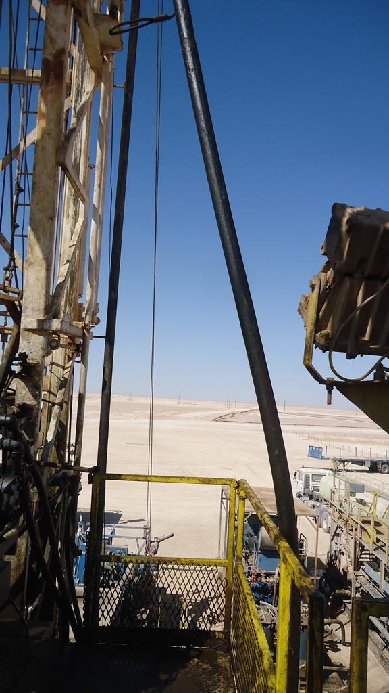
PDO Safety Advice
Use this Alert: Discuss in Tool Box Talks and HSE Meetings ➔ Distribute to contractors ➔ Post on HSE Notice Boards ➔ Include in site HSE Induction
Date: 16-01-2015
Injury: Finger fracture
What happened:
The Assistant Driller was operating the winch to lift the kelly hose to be installed on the drill string. Although it was being guided by the roustabout the hose became snagged on a bolt securing the hand tools board hanging on the rig floor handrail. The assistant driller stopped the winch and then reversed it to lower the kelly hose but at the same time the roustabout went to release the hose manually and his right hand middle finger trapped between tool board and hand rail causing crush injury.
Your learning from this incident..
Always watch the placement of your hand
STOP the activity if anyone is approaching a suspended object
Always follow the instruction from supervisor and SOP
Never intervene to correct obstacles without stopping the activity
Contact: MSE34 for further information Learning No 04 16/01/2015

Slide 2
Management learning's
Distribute to contractors ➔ Post on HSE Notice Boards
Date: 16-01-2015
Injury: Finger fracture
As a learning from this incident and ensure continual improvement all contract
managers are to review their HSE HEMP against the questions asked below
Confirm the following:
Are you sure Management of Change (MoC) is prepared prior to any equipment install?.
Are you sure home made arrangements are properly risk assessed prior to the installation?.
Is the alert/learning advice understood by the crew members?
Do you have a system to ensure actions from lateral Learning's are implemented?.
Contact: MSE34 for further information Learning No 03 12/01/2015

