Slide 1
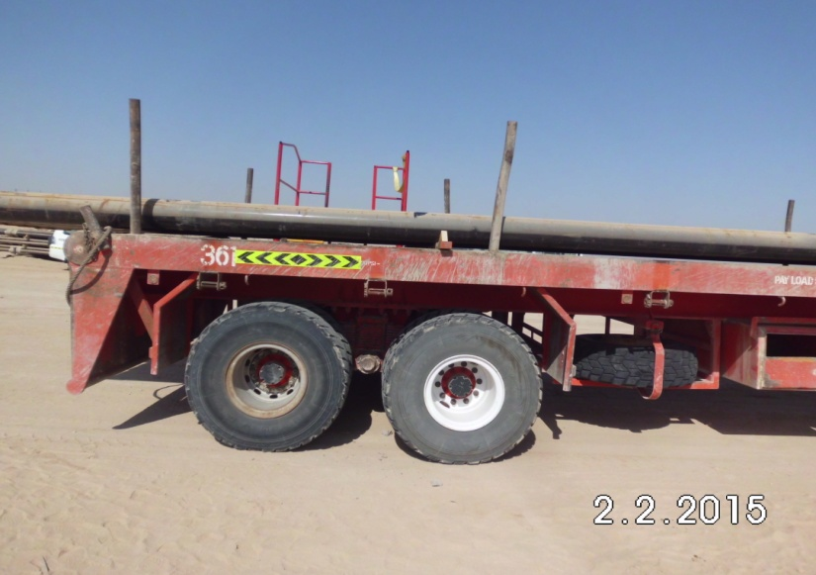

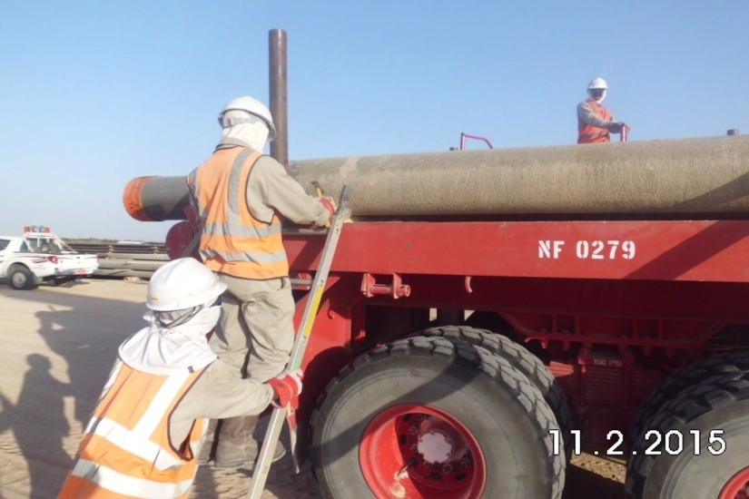
PDO Safety Advice
Use this Alert: Discuss in Tool Box Talks and HSE Meetings ➔ Distribute to contractors ➔ Post on HSE Notice Boards ➔ Include in site HSE Induction
Date: 02-02-2015
Injury: Fractured Wrist
What happened?
A member of a casing yard crew fell from a trailer whilst nailing a chock into dunnage for the first layer of casing joints, the Injured Person (IP) states he felt dizzy and lost consciousness resulting in him falling. He was on the opposite side of the vehicle to the working platforms provided. He fractured his right wrist as a result of the fall.
Your learning from this incident..
Ensure procedures are sufficient for task, in place and followed
Stop work and inform your supervisor / foreman if you feel unwell or unable to carry a task out safely.
Identify the correct equipment for task.
Stop work if the correct equipments isn't available for the task.
Beware of your surroundings and hazards around your working area.
Photo explaining what was done wrong
IP on edge of trailer not using platform or ladders
Photo explaining how it should be done right
3 points of contact on ladder
Employee footing ladder
Where possible complete tasks at ground level
Contact: MSE34 for further information Learning No 05 02/02/2015

Slide 2
Management learning's
Distribute to contractors ➔ Post on HSE Notice Boards
Date: 02-02-2015
Injury: Fractured Wrist
As a learning from this incident and ensure continual improvement all contract
managers are to review their HSE HEMP against the questions asked below
Confirm the following:
Have your staff got the correct equipment to carry out their work safely?
Do your tool box talks include asking if your staff feel well and fit to work?
Can tasks be carried out at ground level instead of working at height?
Is the alert /Learning understood by the crew members?
Do you have a system to ensure actions from lateral learning’s are implemented?
Contact: MSE34 for further information Learning No 05 02/02/2015

