Slide 1

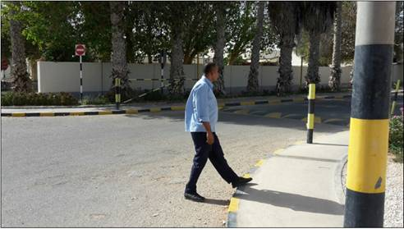


PDO Incident First Alert
Incident type | LTI(#14) | PIM ID | 1089179
Date/ time | 08/04/2015 (10:00 hrs) | Directorate
Location | Sahara PAC - Rhima | Dept
What happened
Whilst crossing a roadway the camp boss stumbled when stepping on to the pavement and fell heavily with his shin falling onto the kerb stone. He fractured both his shin bones as a result
Mr. Musleh asks the questions of can it happen to you?
Do always pay attention to where you are stepping?
Do you take care when stepping up or down?
Do you always wear the correct footwear?
Do you avoid walking being distracted on the phone?
Raised pavement
Please disseminate this LTI notification to your teams and use it in your tool box talks and HSE meetings and notice boards.

